Slide 1
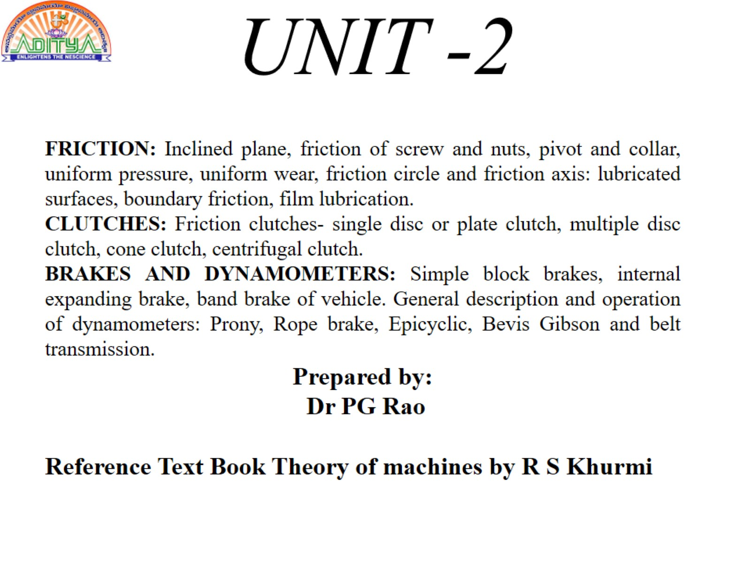

Slide 2
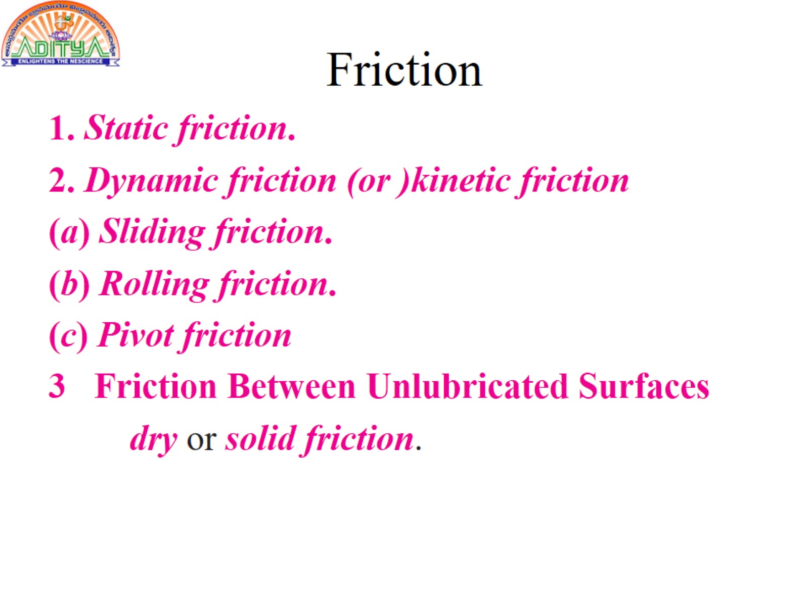
Friction

Slide 3
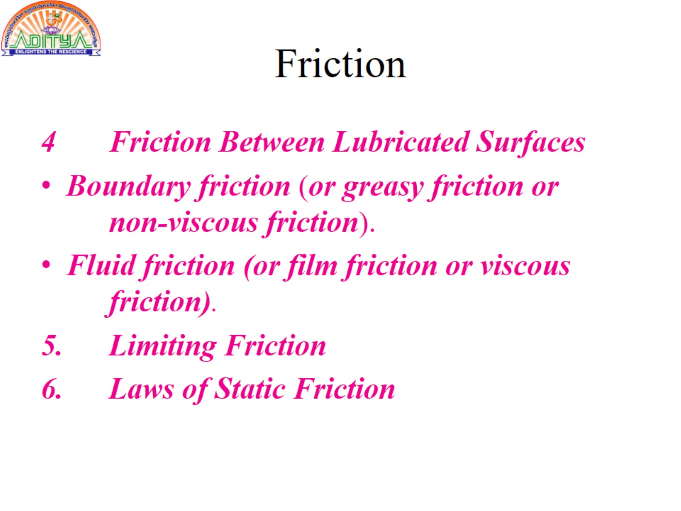
Friction

Slide 4
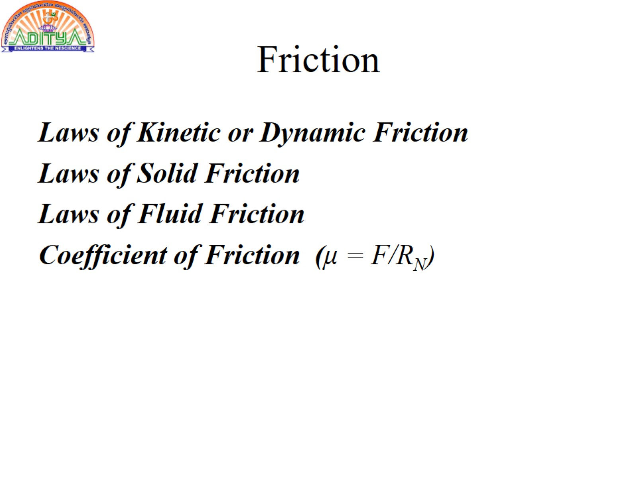
Friction

Slide 5
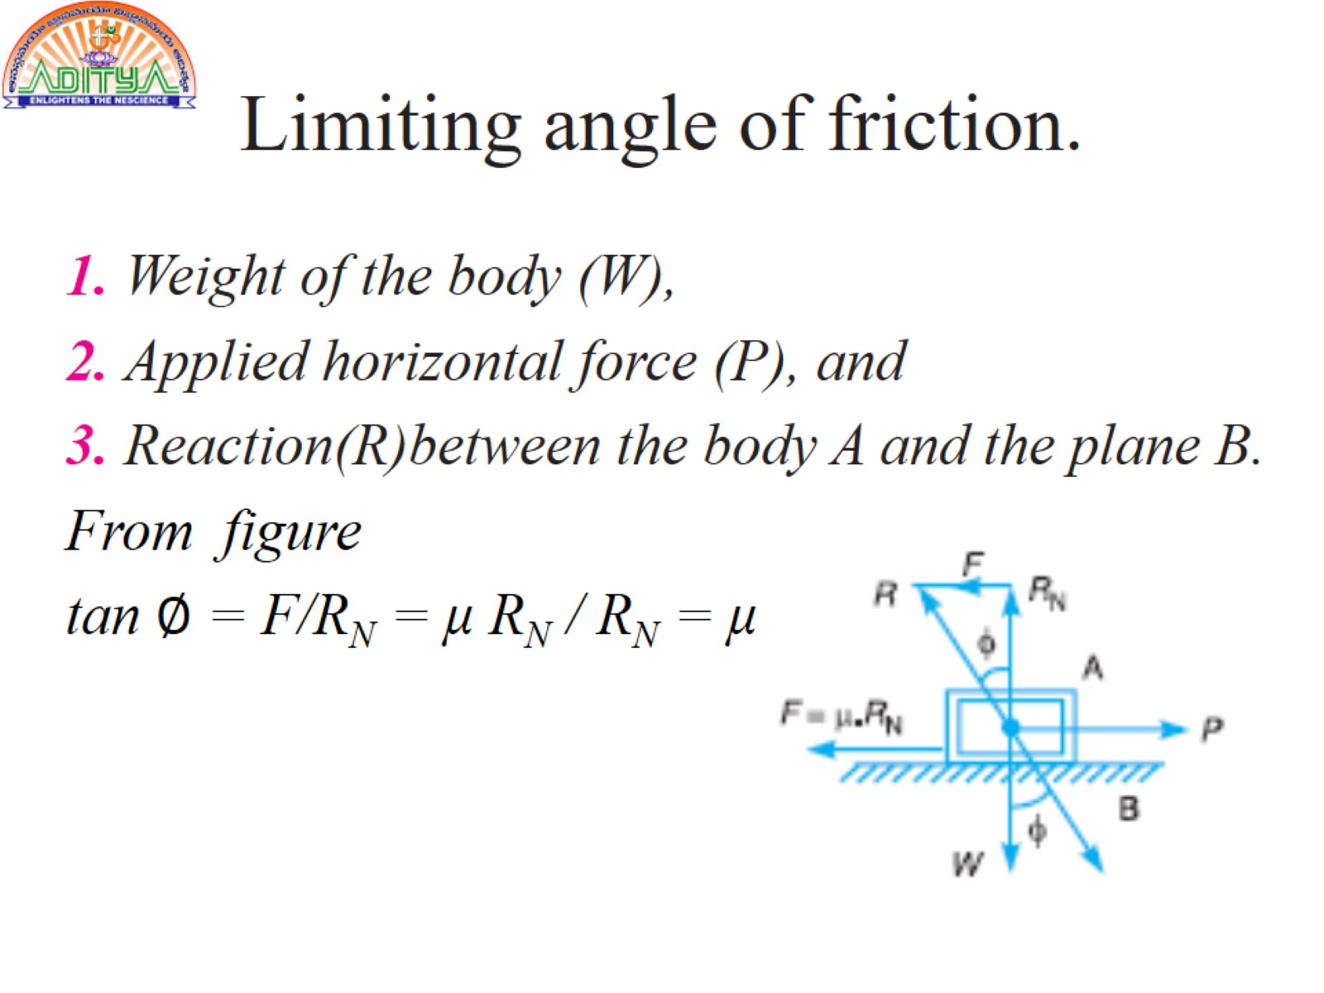
Limiting angle of friction.

Slide 6
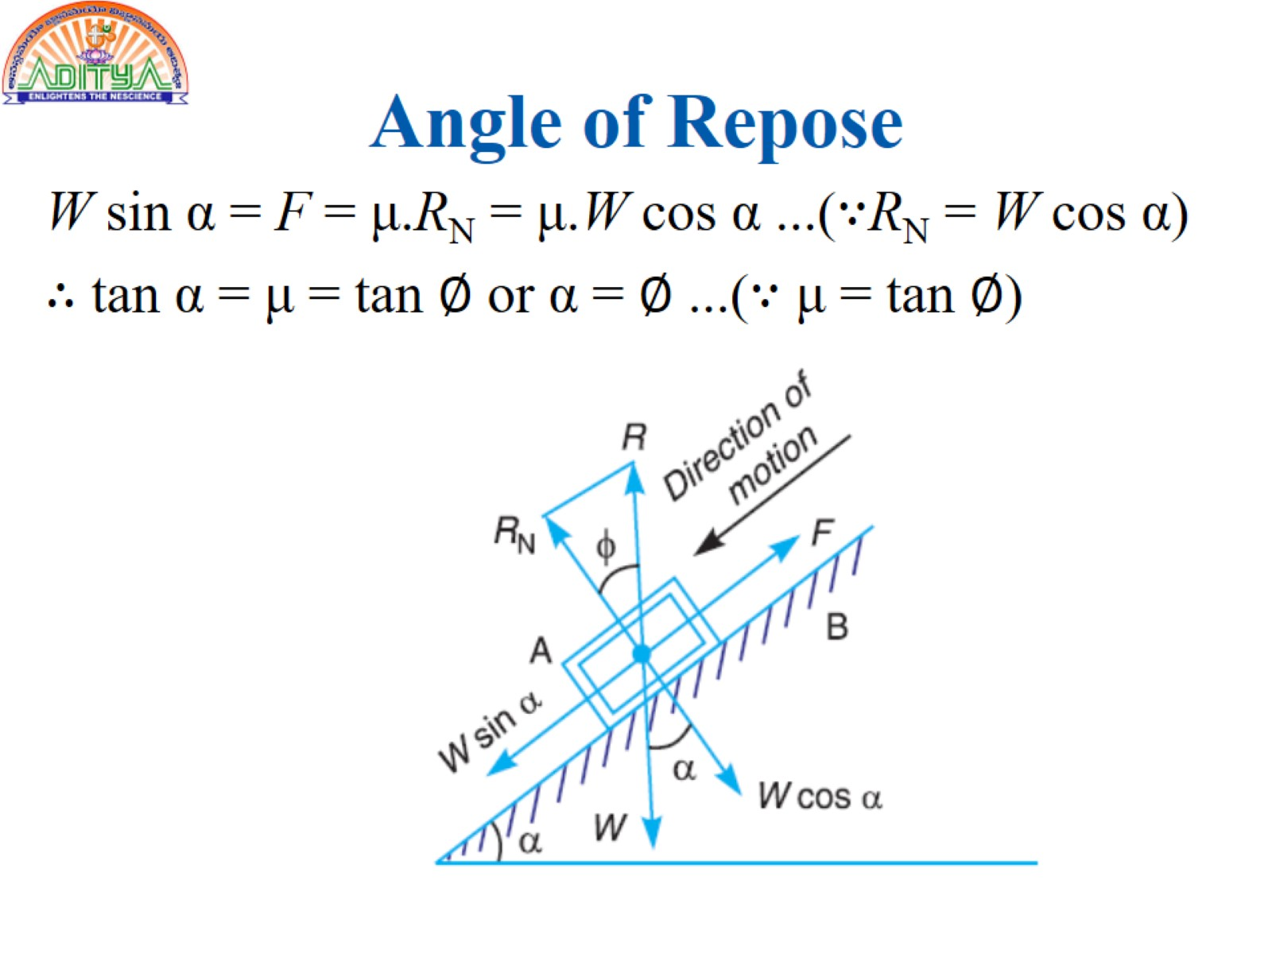
Angle of Repose

Slide 7
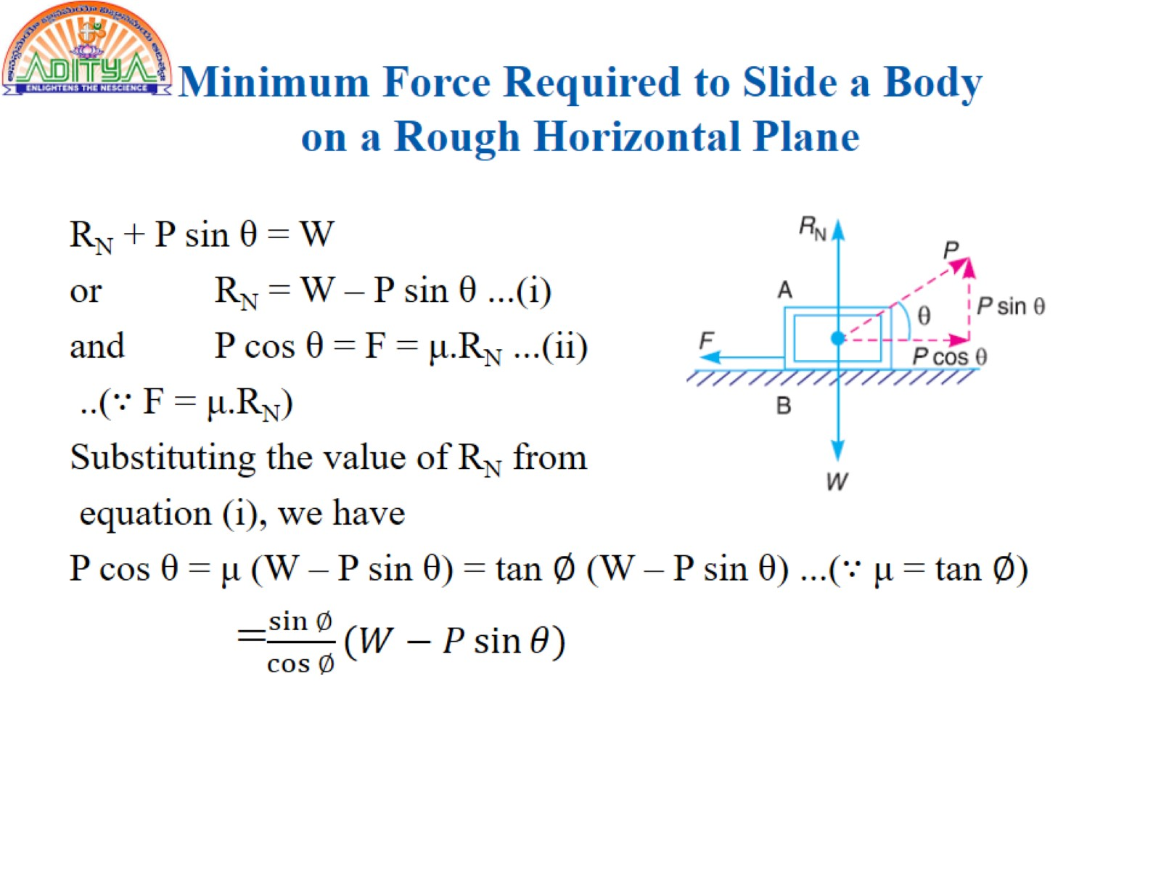
Minimum Force Required to Slide a Body on a Rough Horizontal Plane

Slide 8
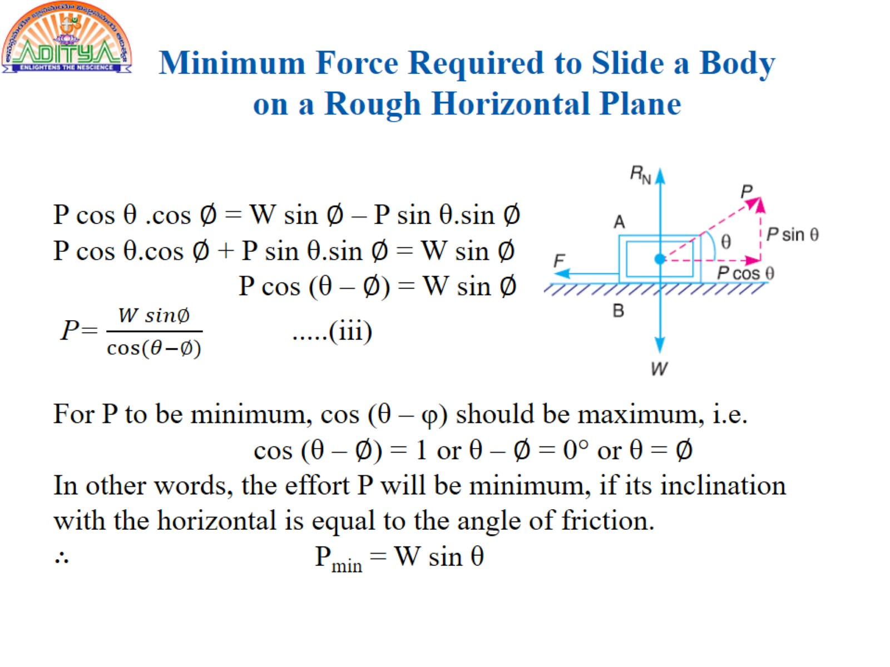
Minimum Force Required to Slide a Body on a Rough Horizontal Plane

Slide 9
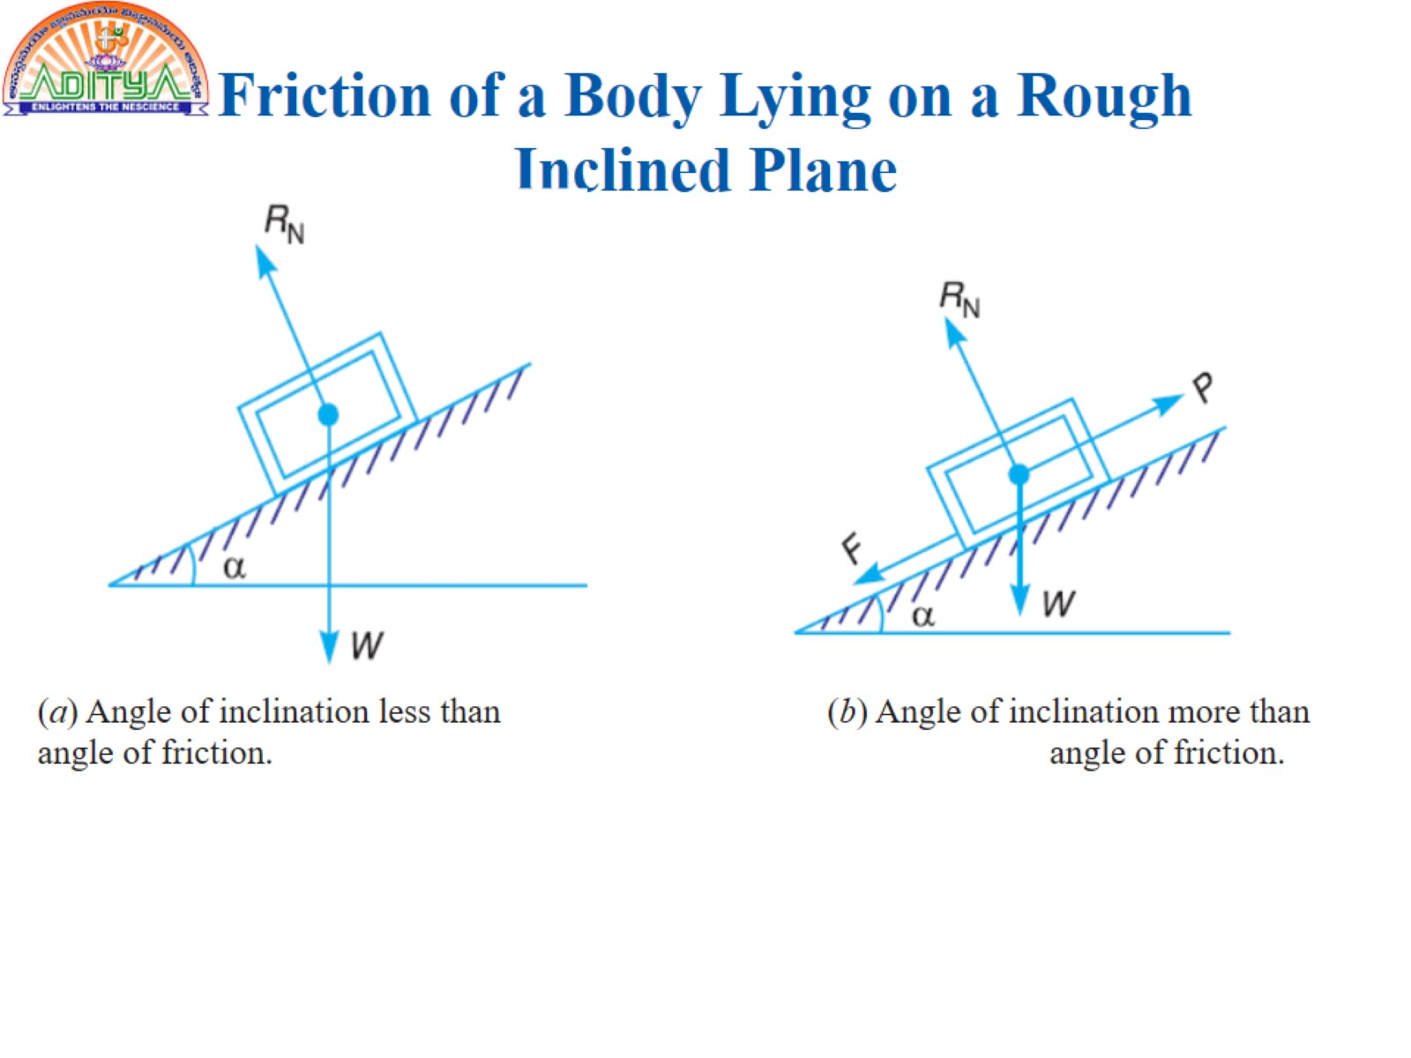
Friction of a Body Lying on a Rough
Inclined Plane

Slide 10
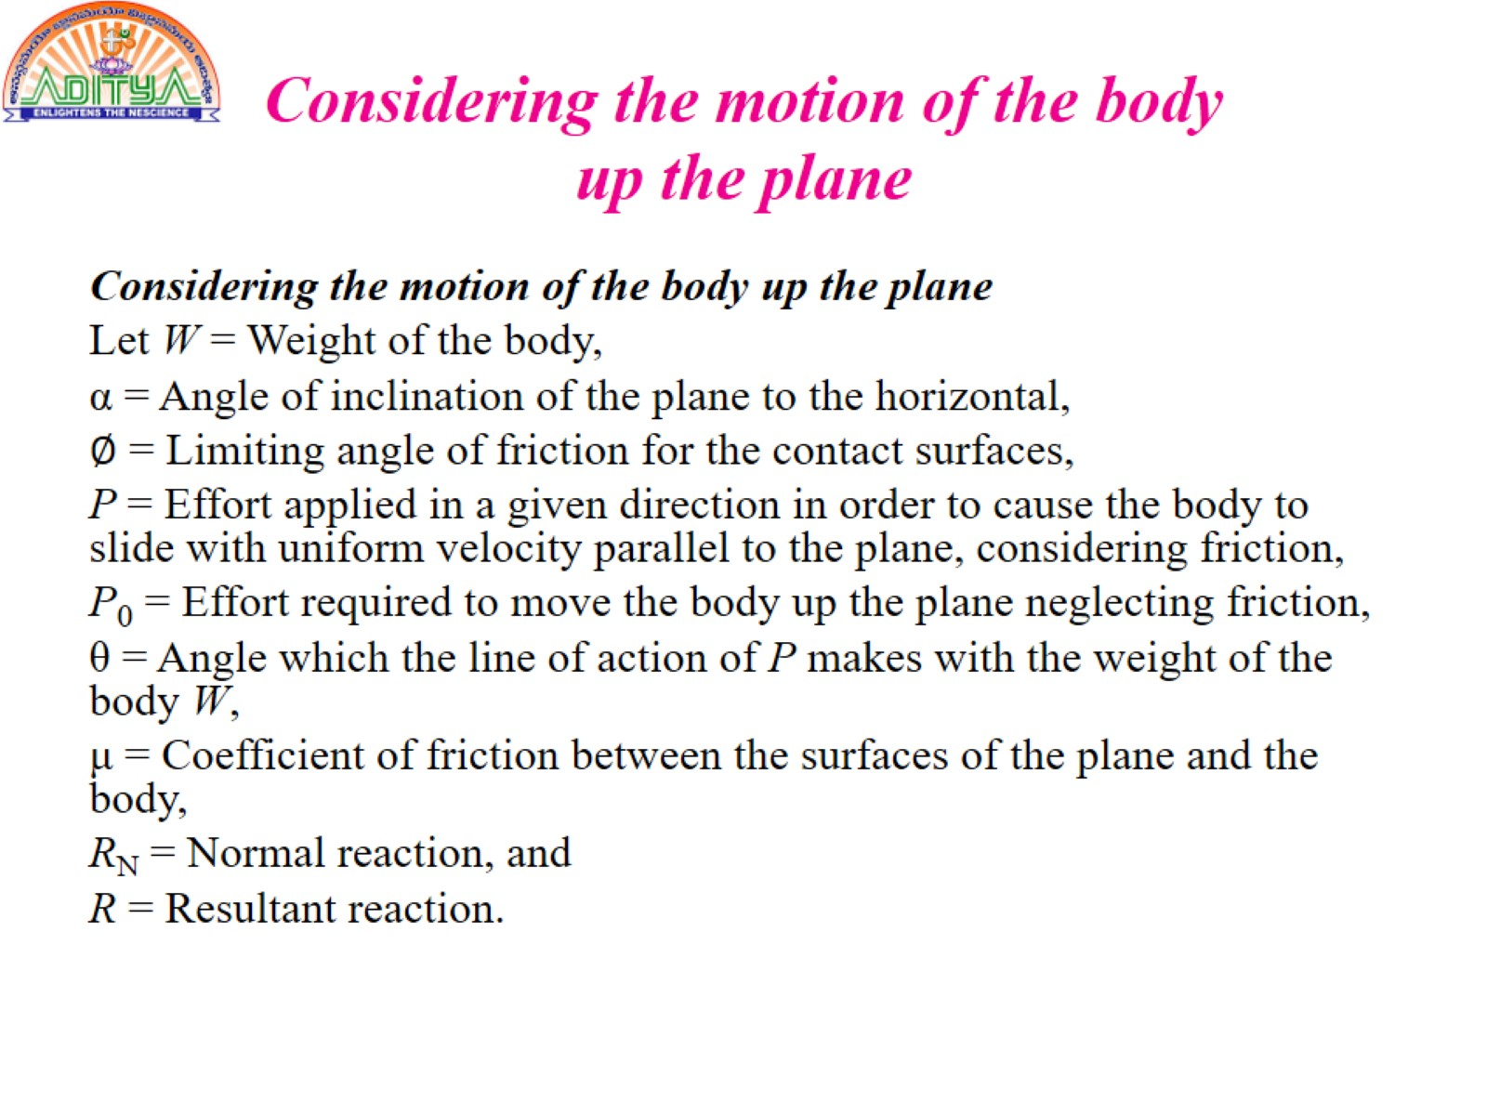
Considering the motion of the body up the plane

Slide 11
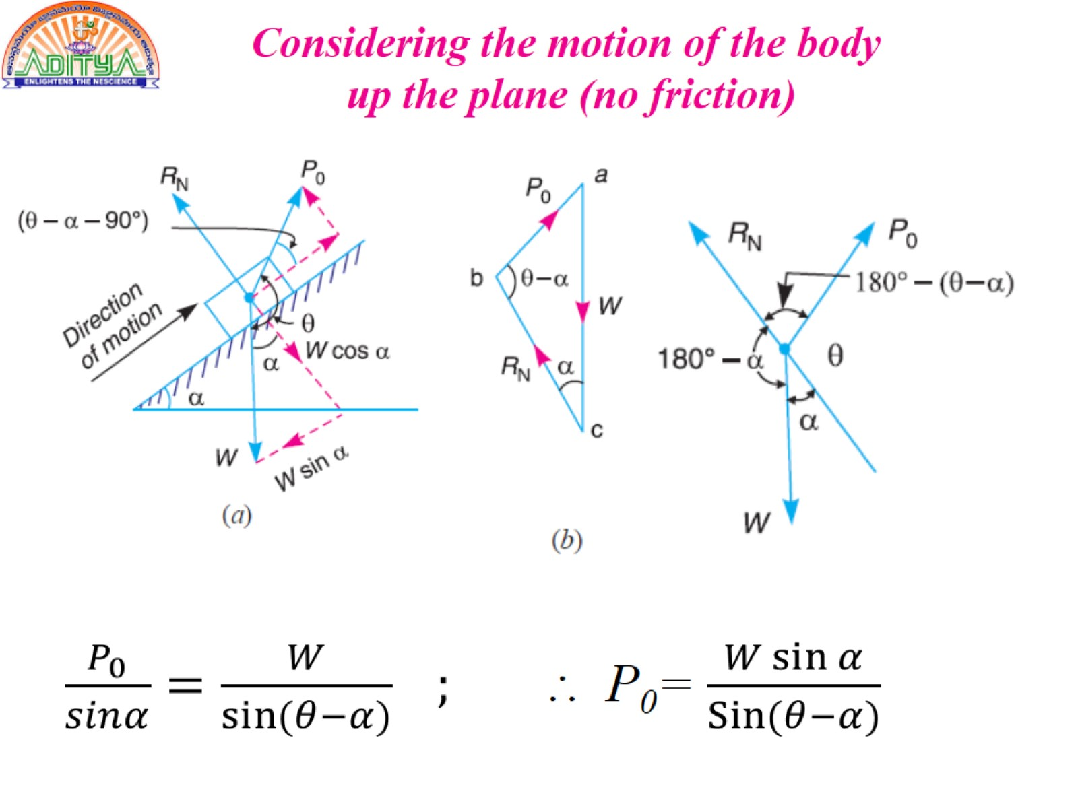
Considering the motion of the body up the plane (no friction)

Slide 12
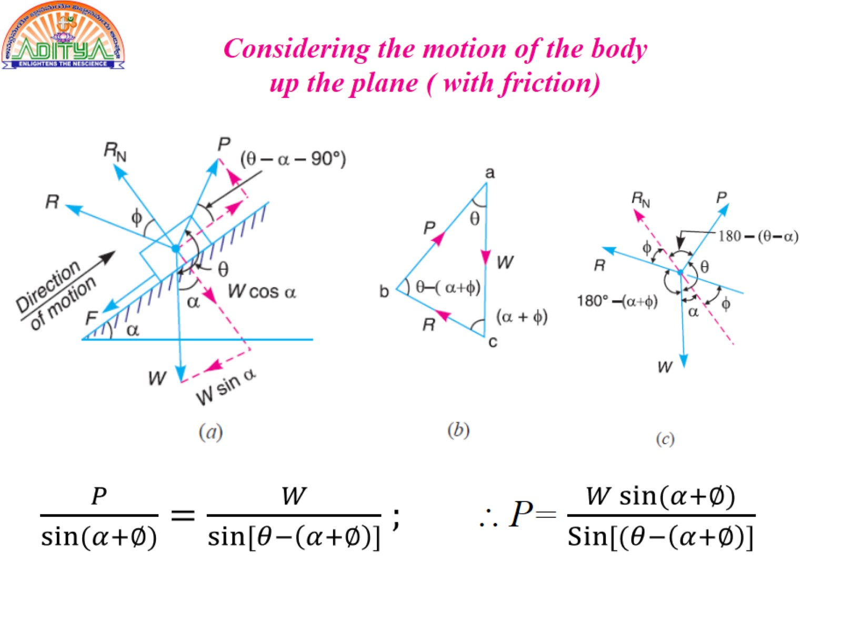
Considering the motion of the body up the plane ( with friction)

Slide 13
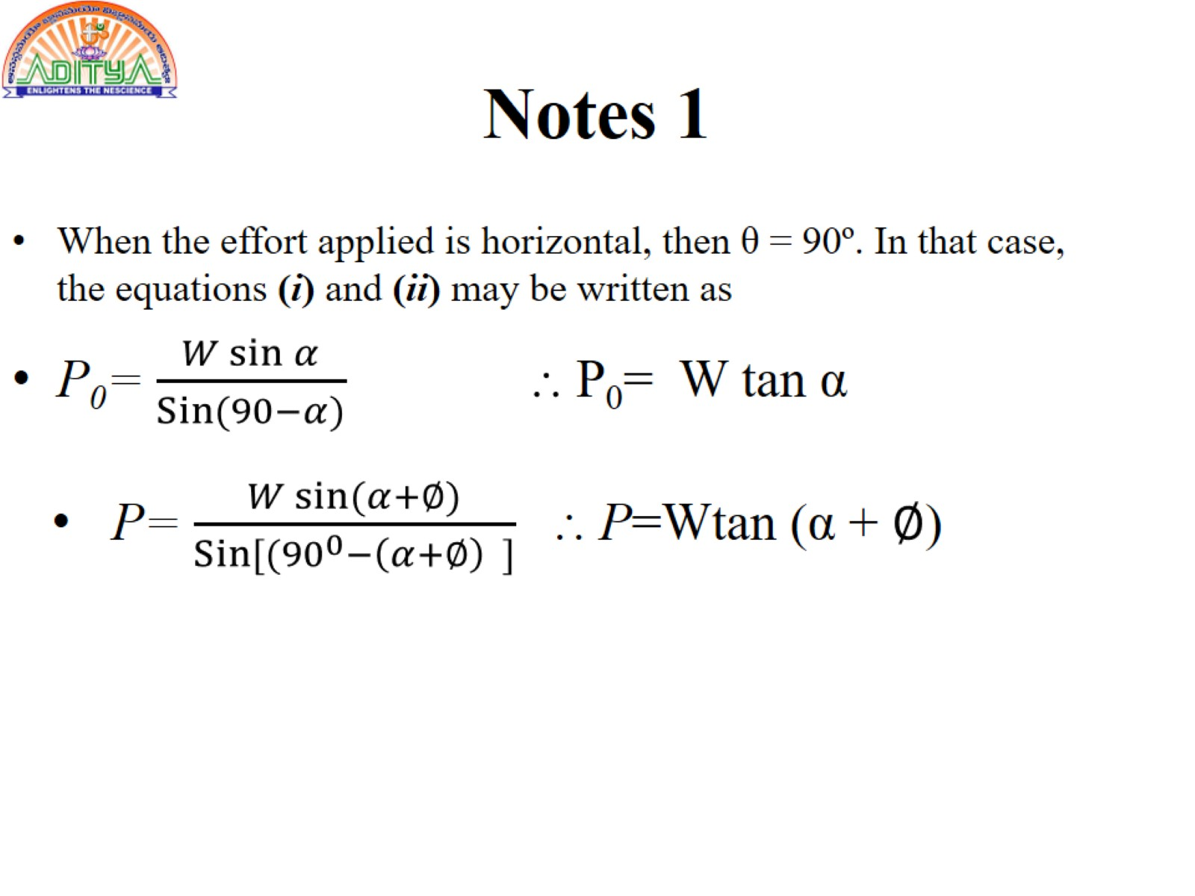
Notes 1

Slide 14
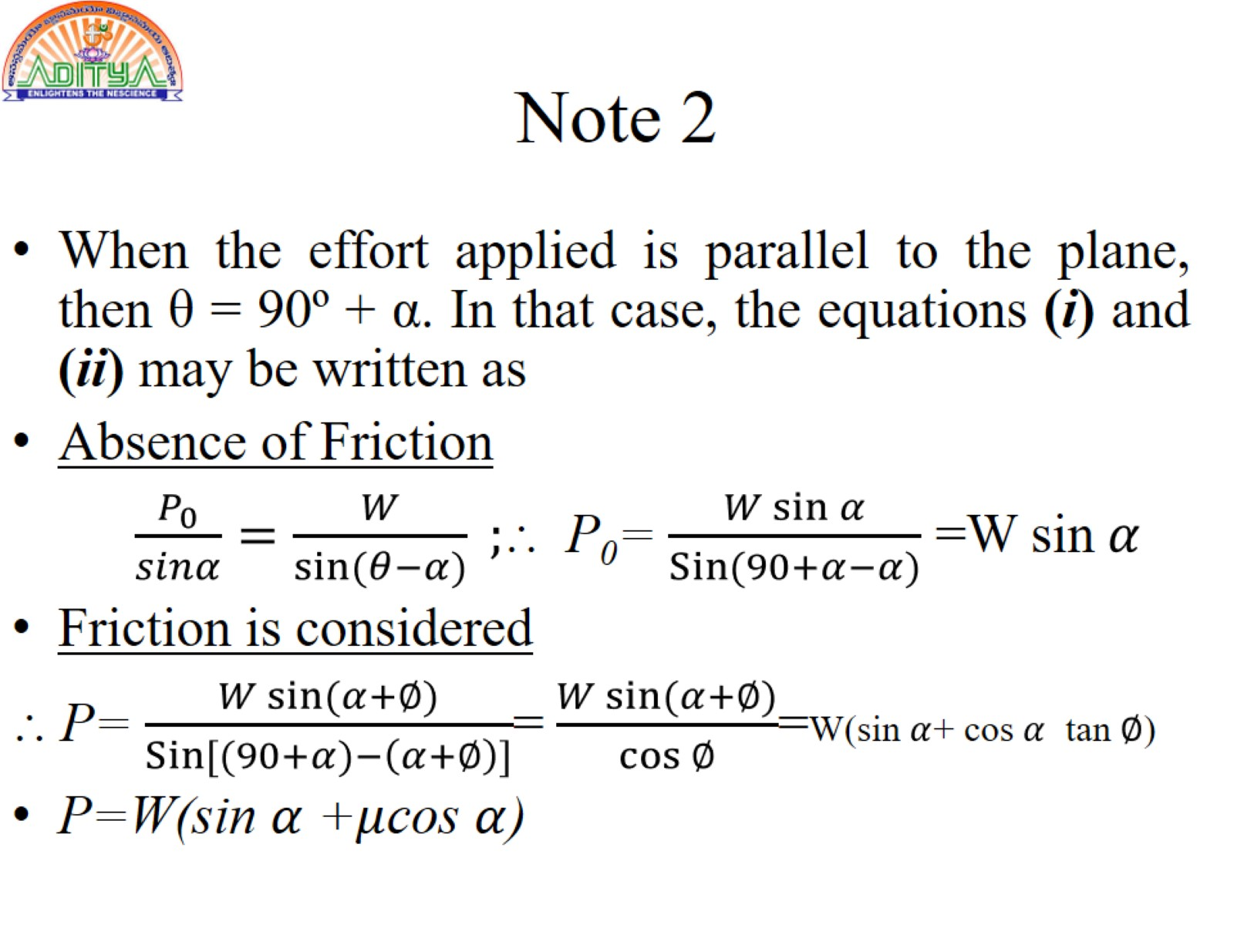
Note 2

Slide 15
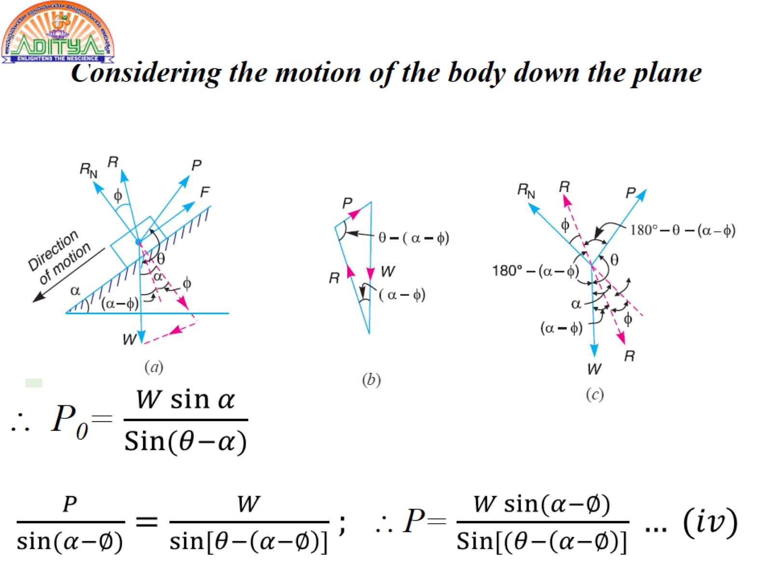
Considering the motion of the body down the plane

Slide 16
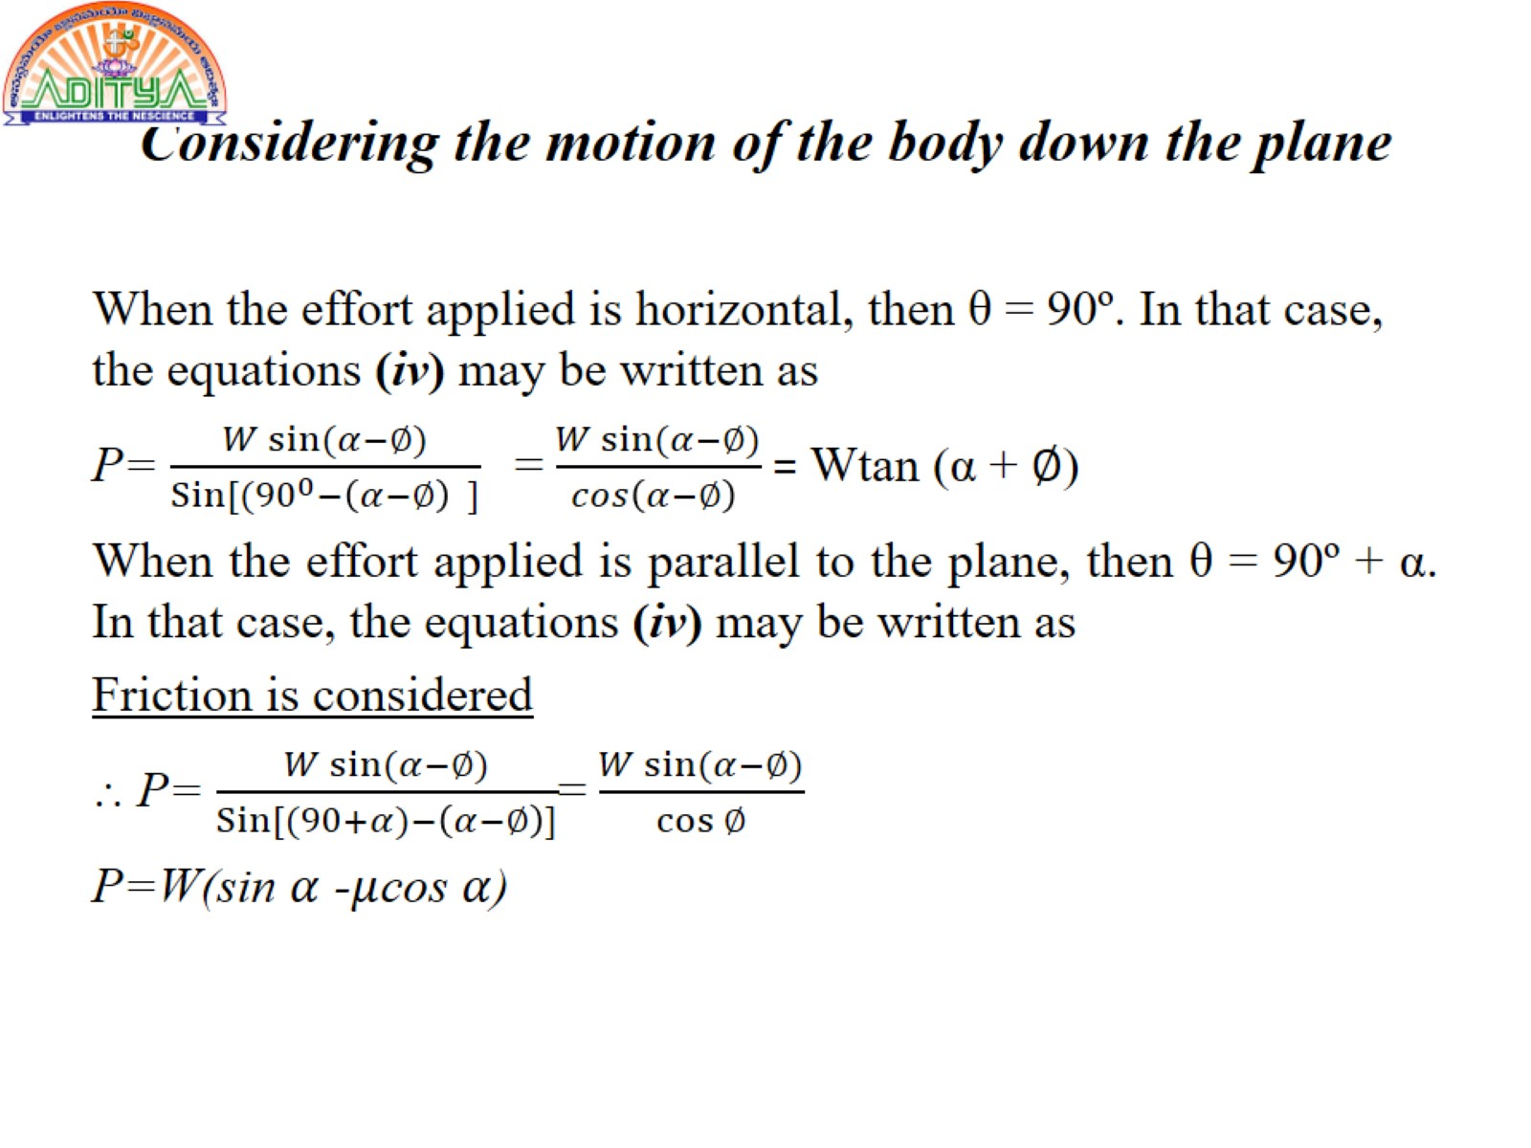
Considering the motion of the body down the plane

Slide 17
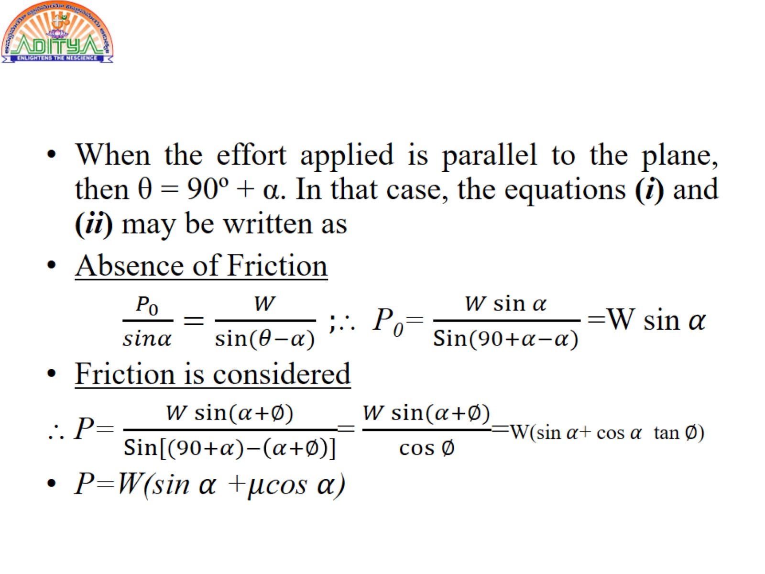

Slide 18
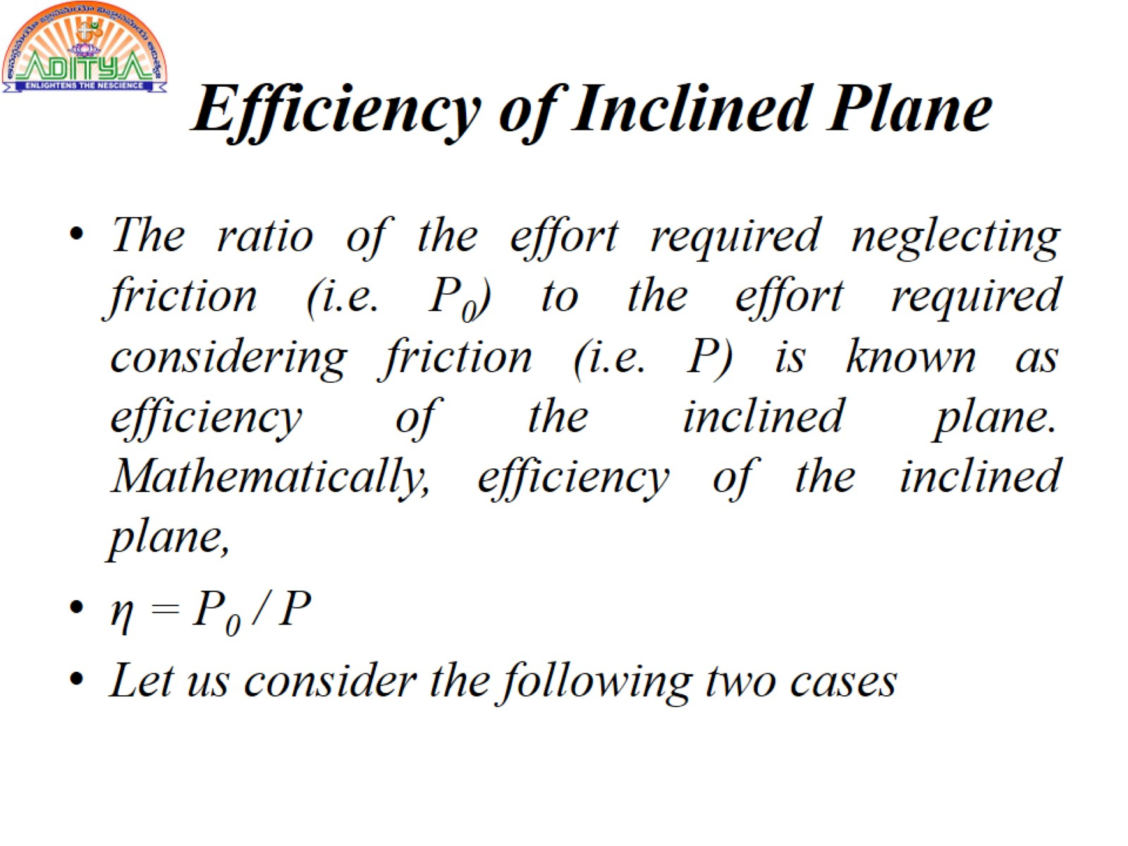
Efficiency of Inclined Plane

Slide 19
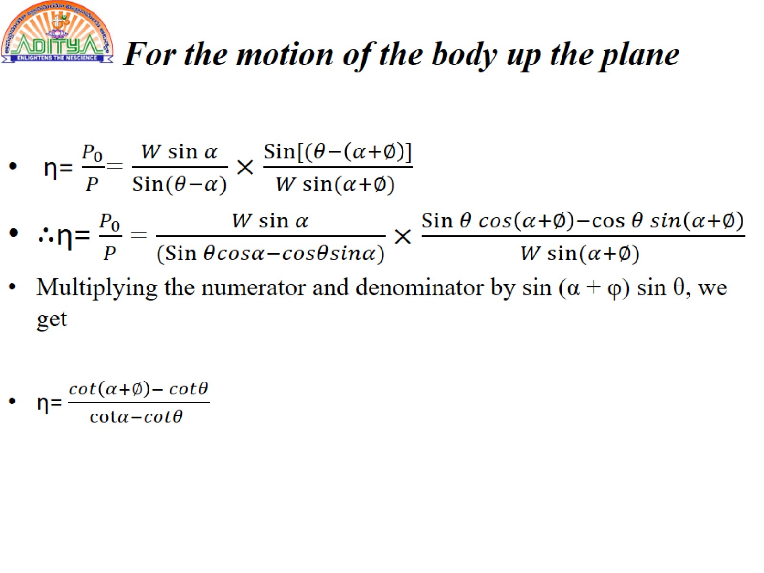
For the motion of the body up the plane

Slide 20
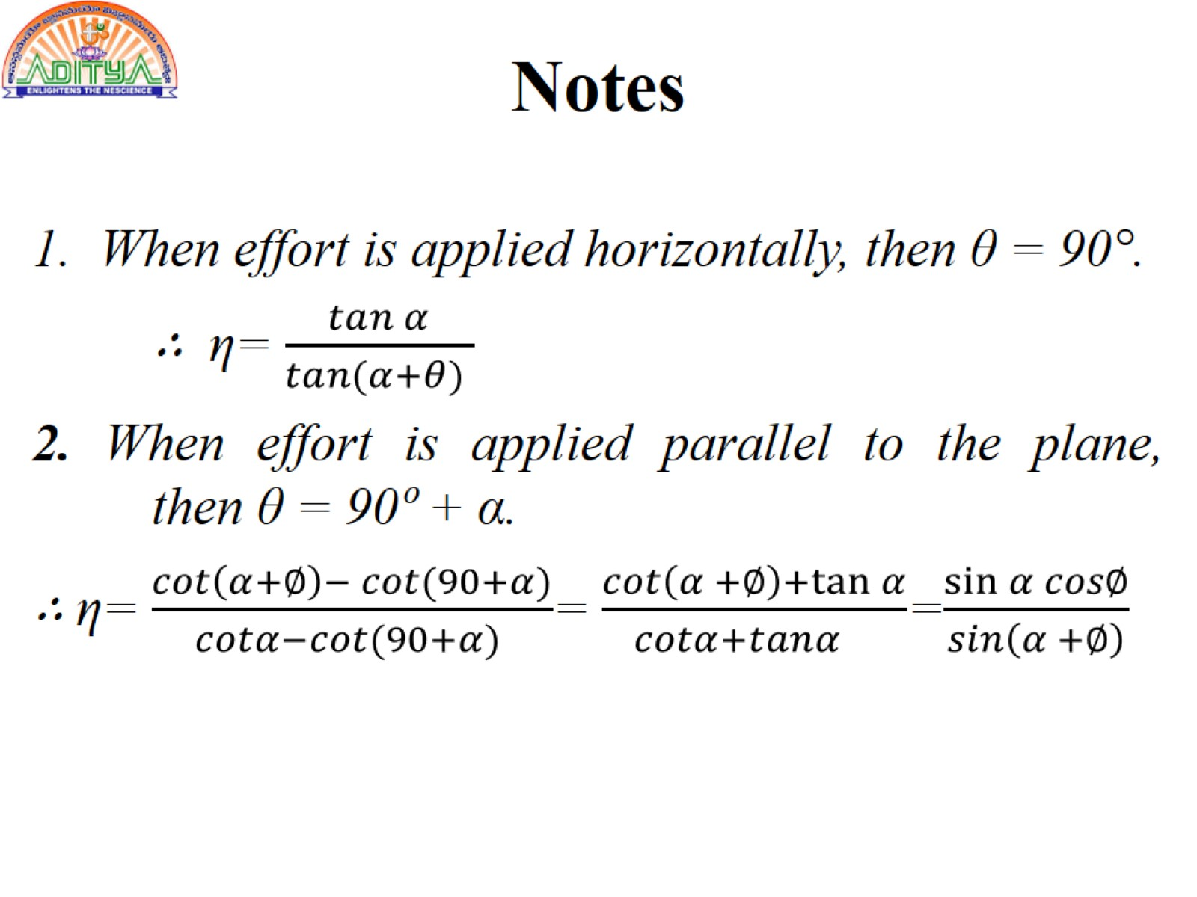
Notes

Slide 21
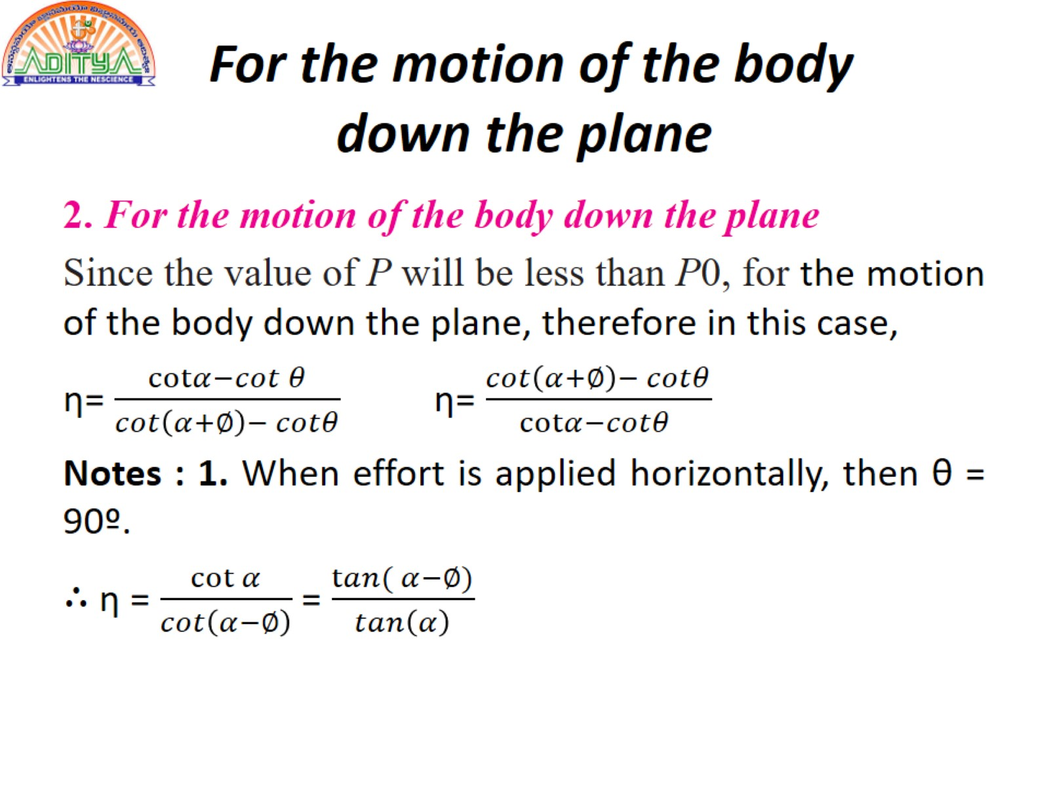
For the motion of the body down the plane

Slide 22
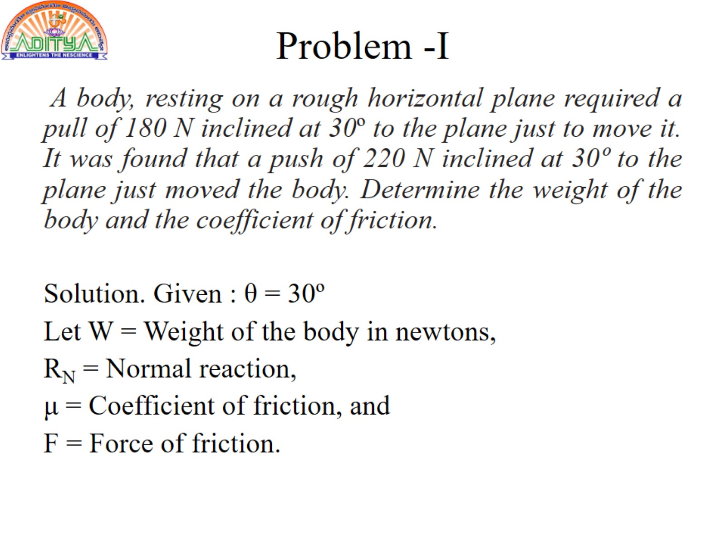
Problem -I

Slide 23
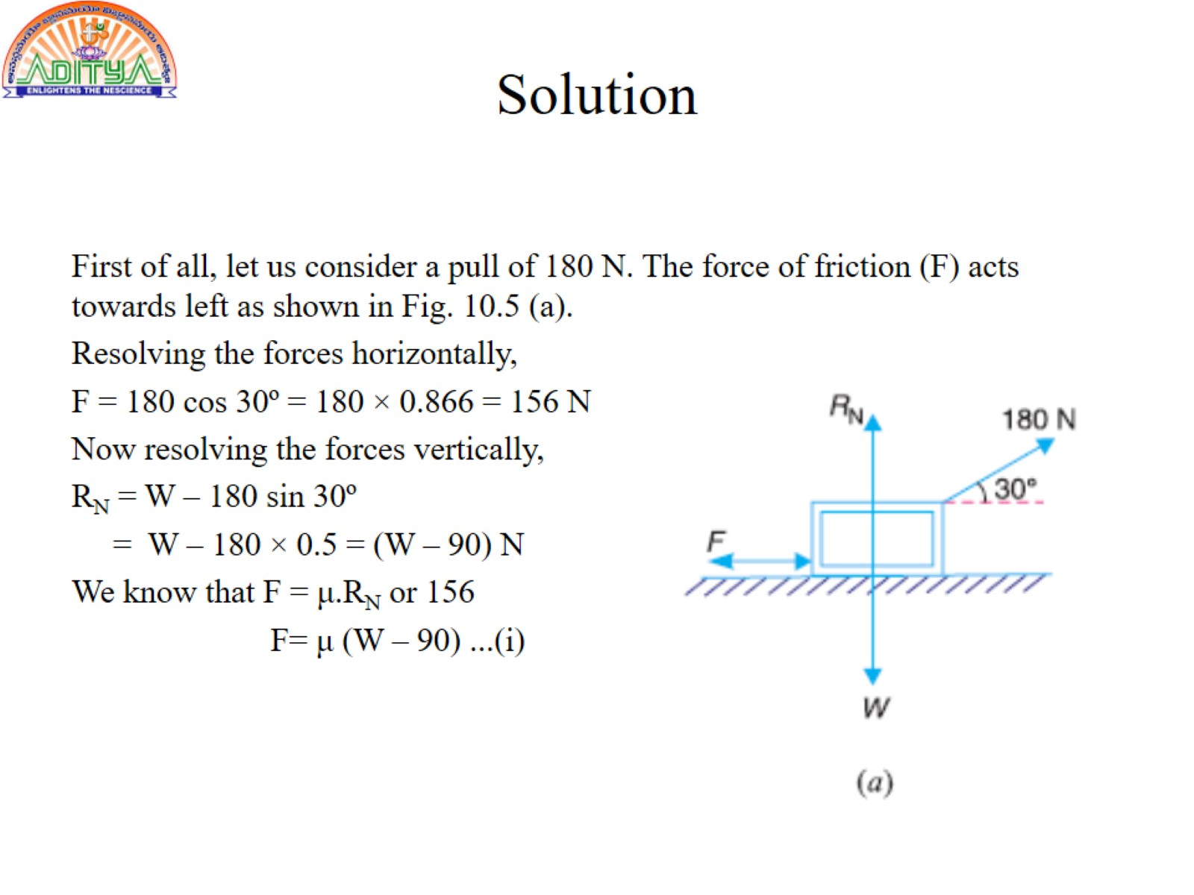
Solution

Slide 24
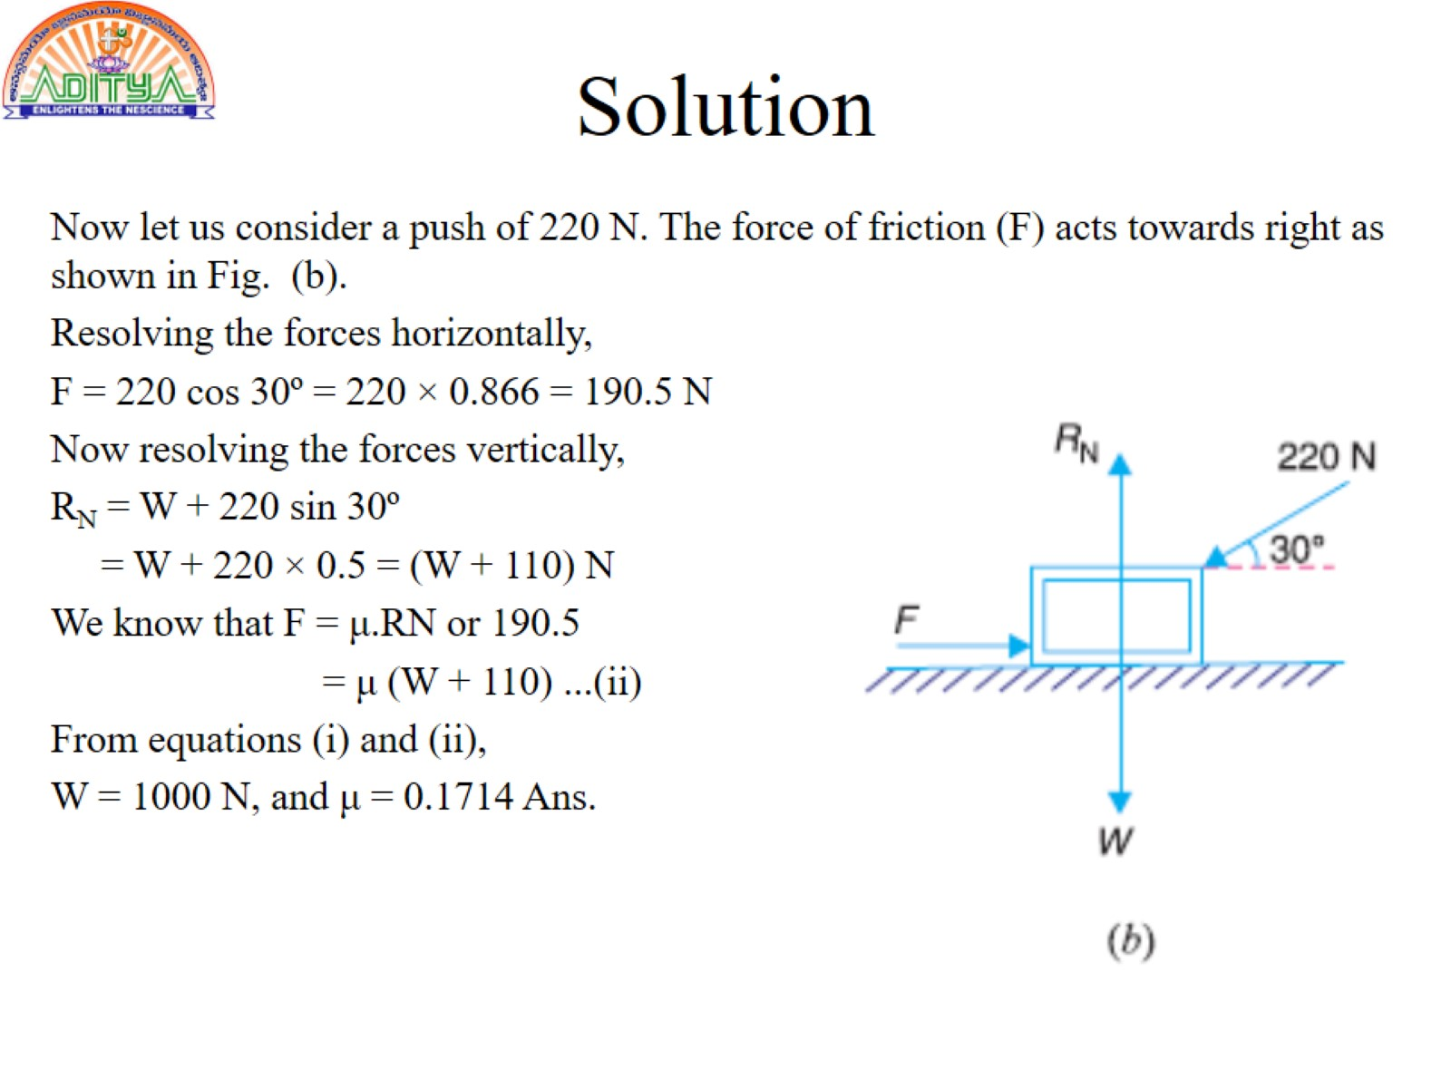
Solution

Slide 25
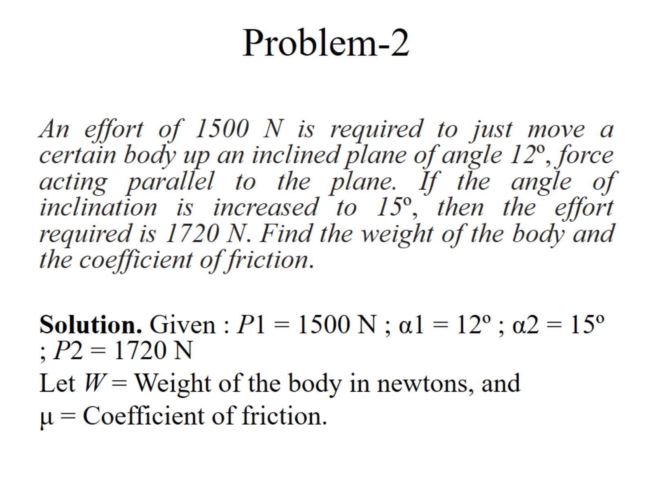
Problem-2

Slide 26
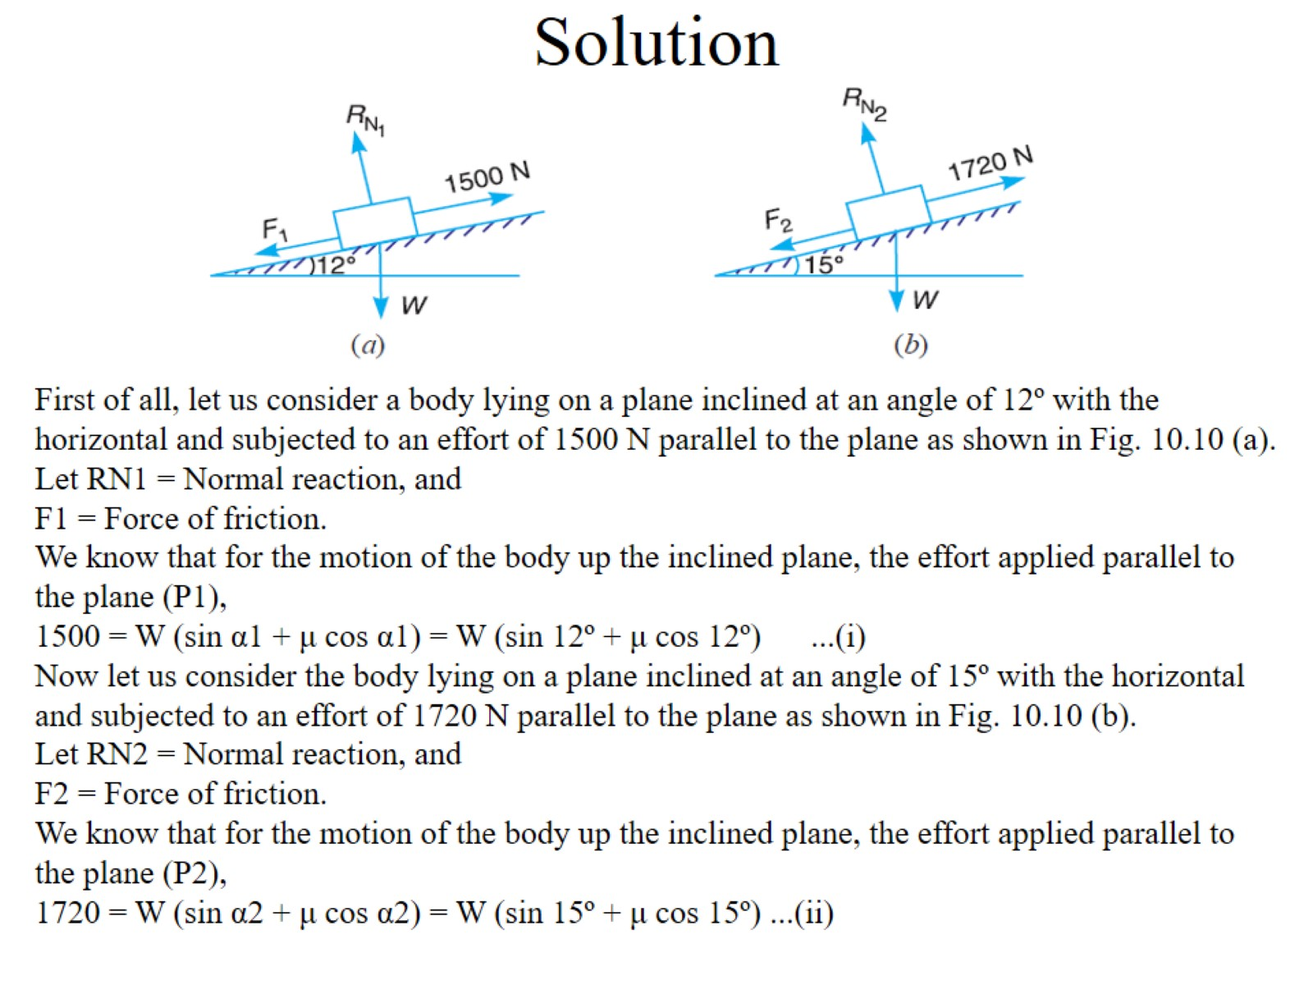
Solution

Slide 27
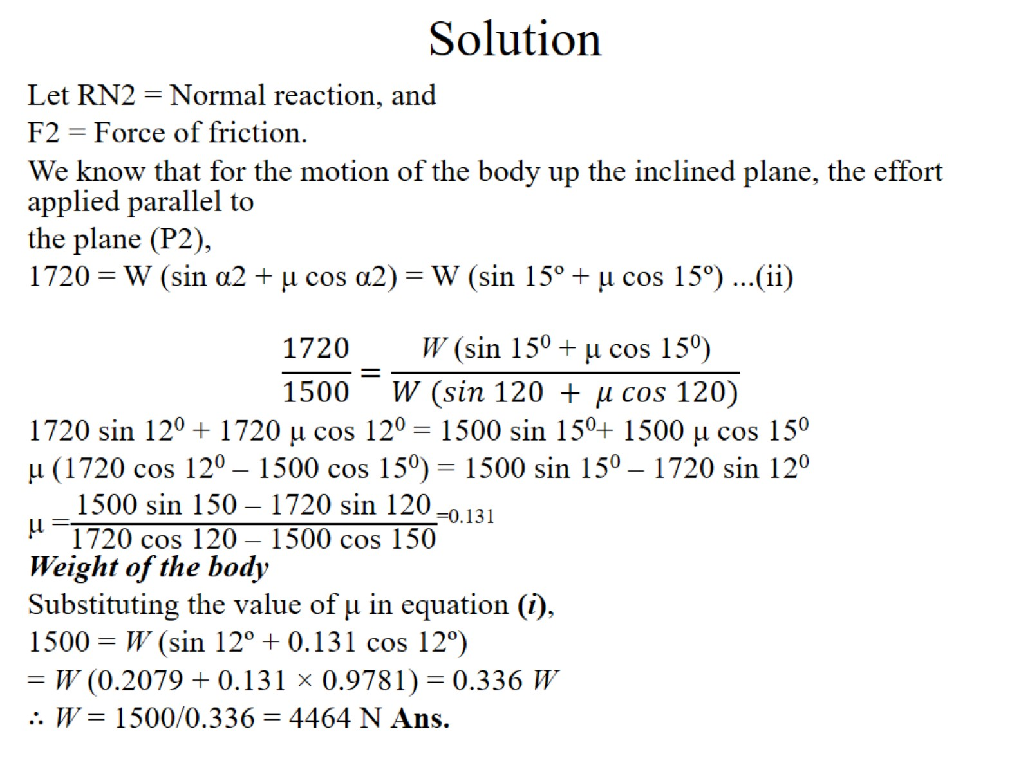
Solution

Slide 28
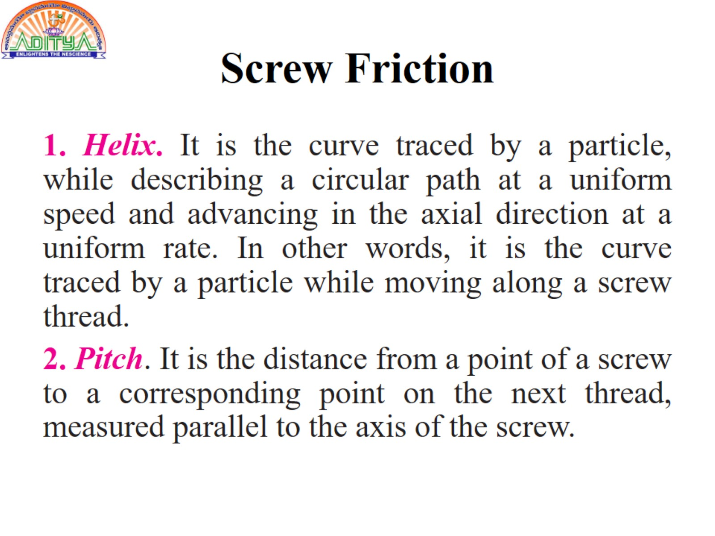
Screw Friction

Slide 29
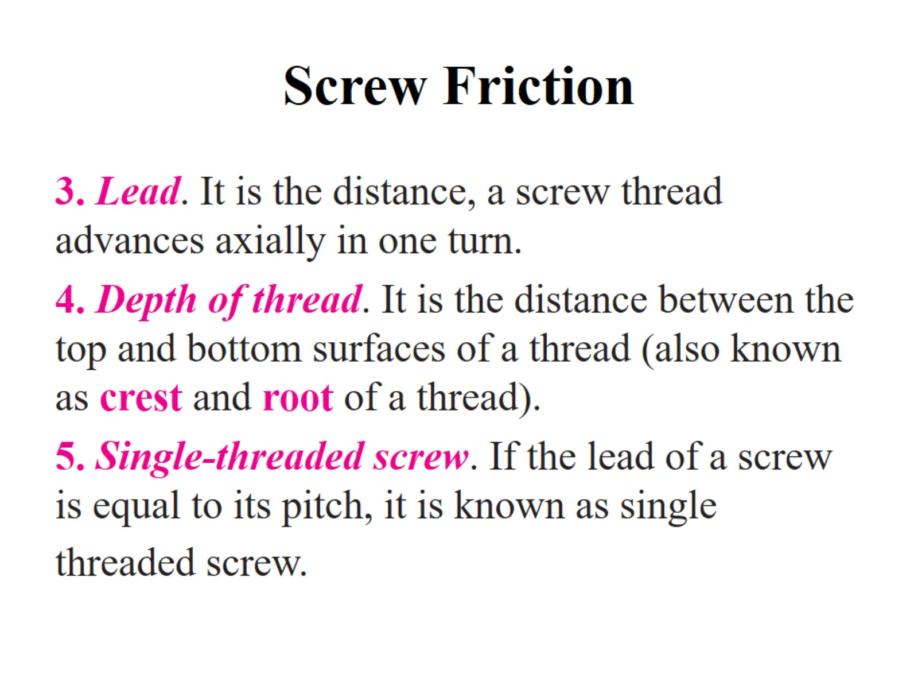
Screw Friction

Slide 30
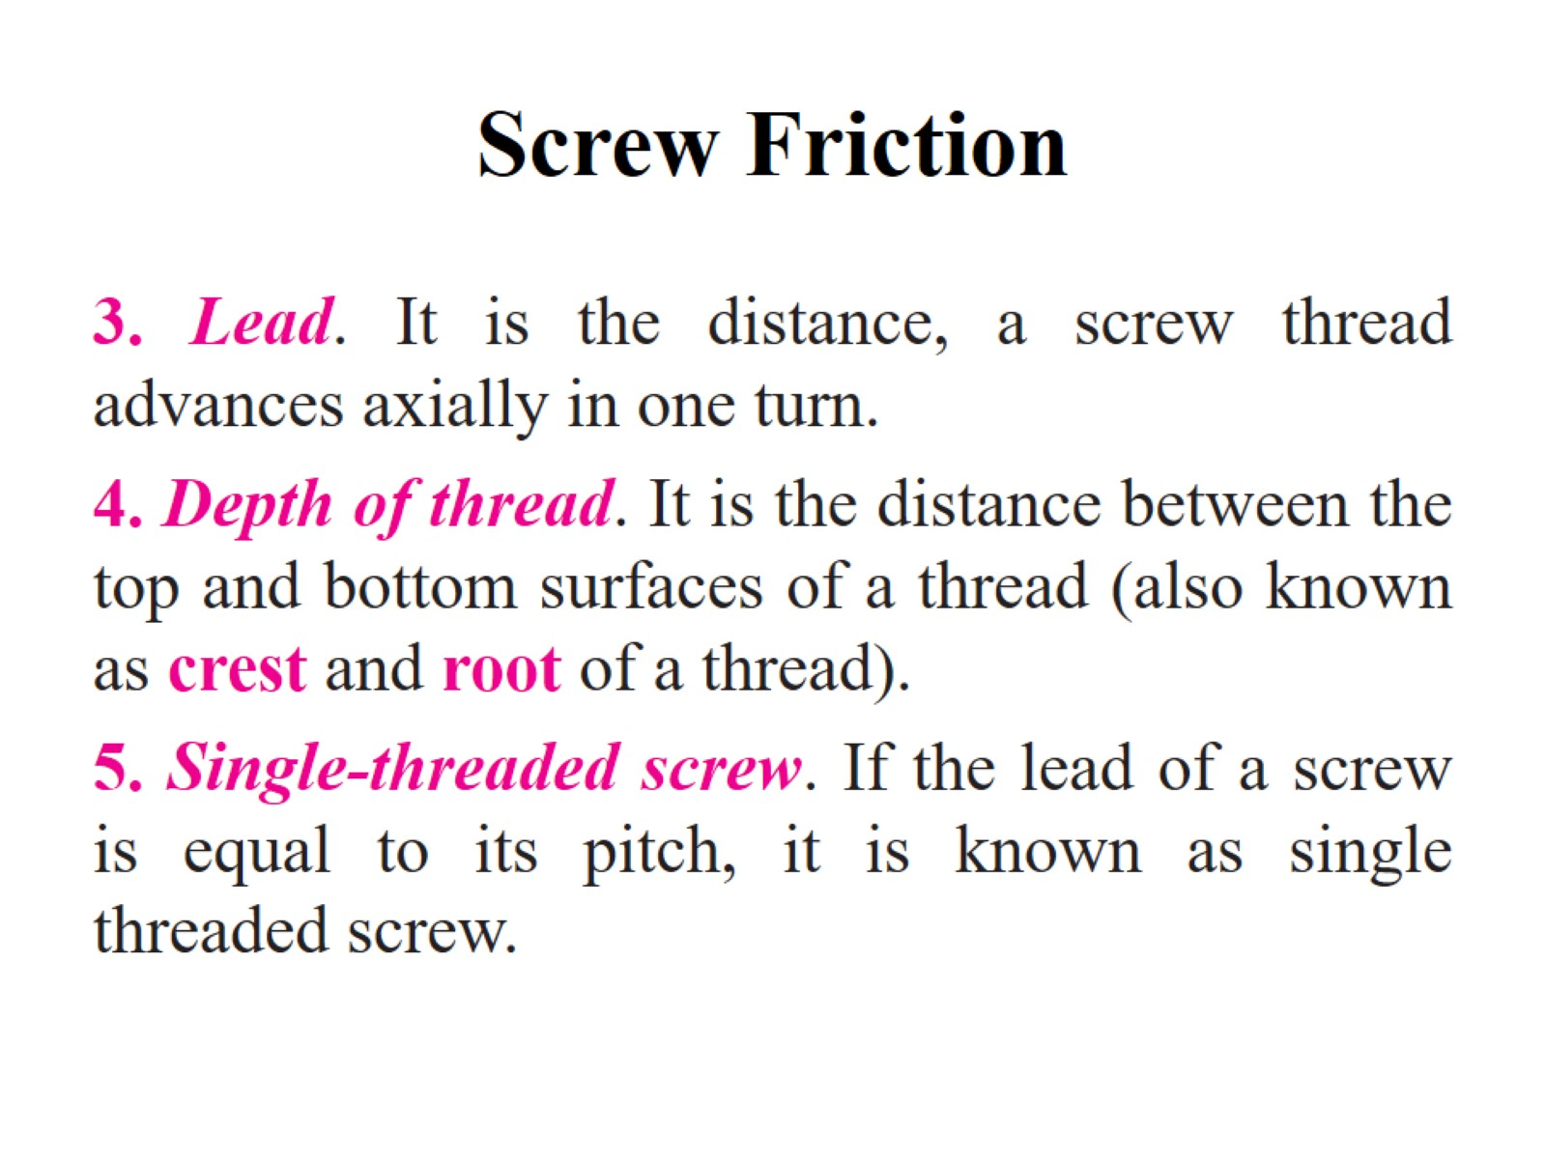
Screw Friction

Slide 31
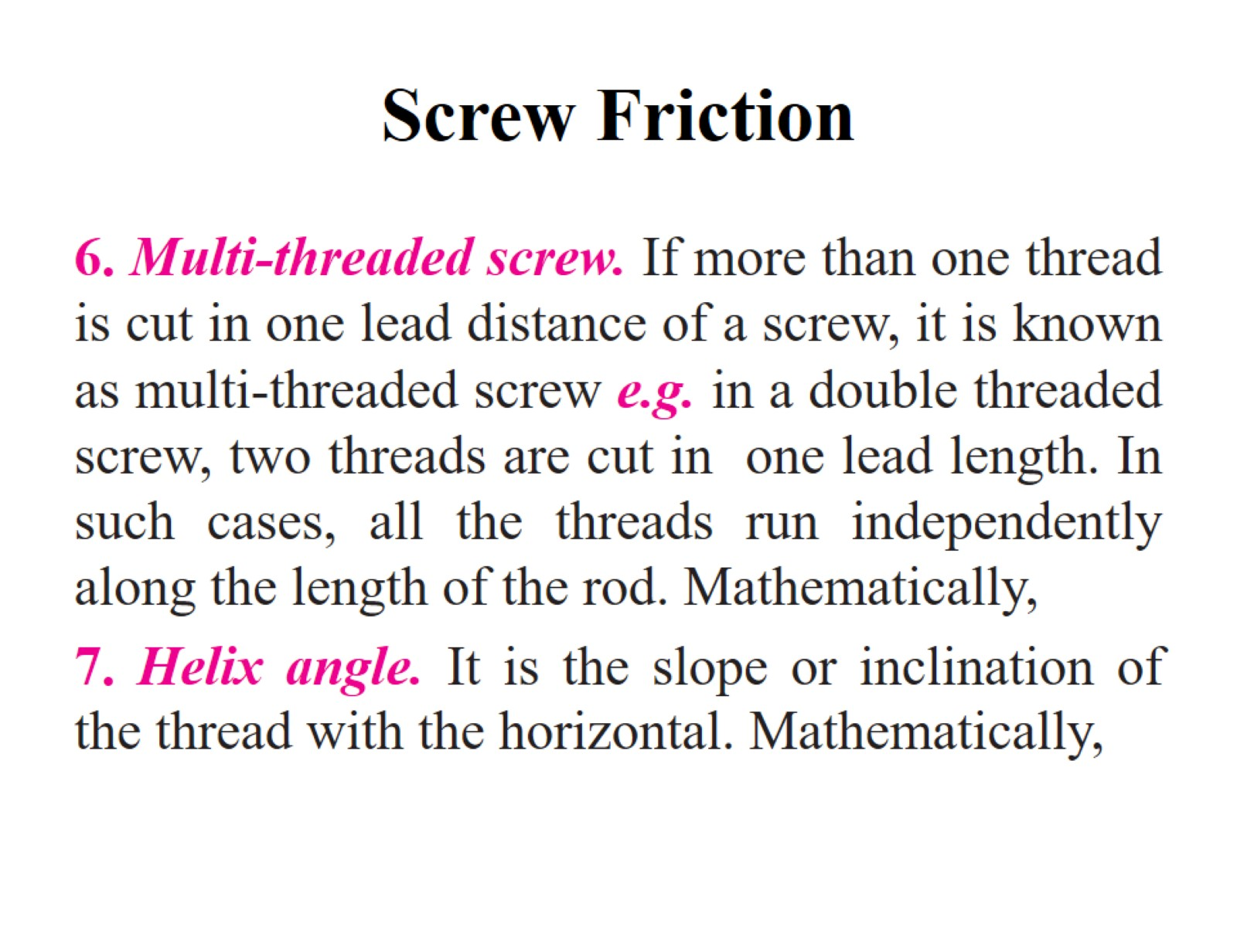
Screw Friction

Slide 32
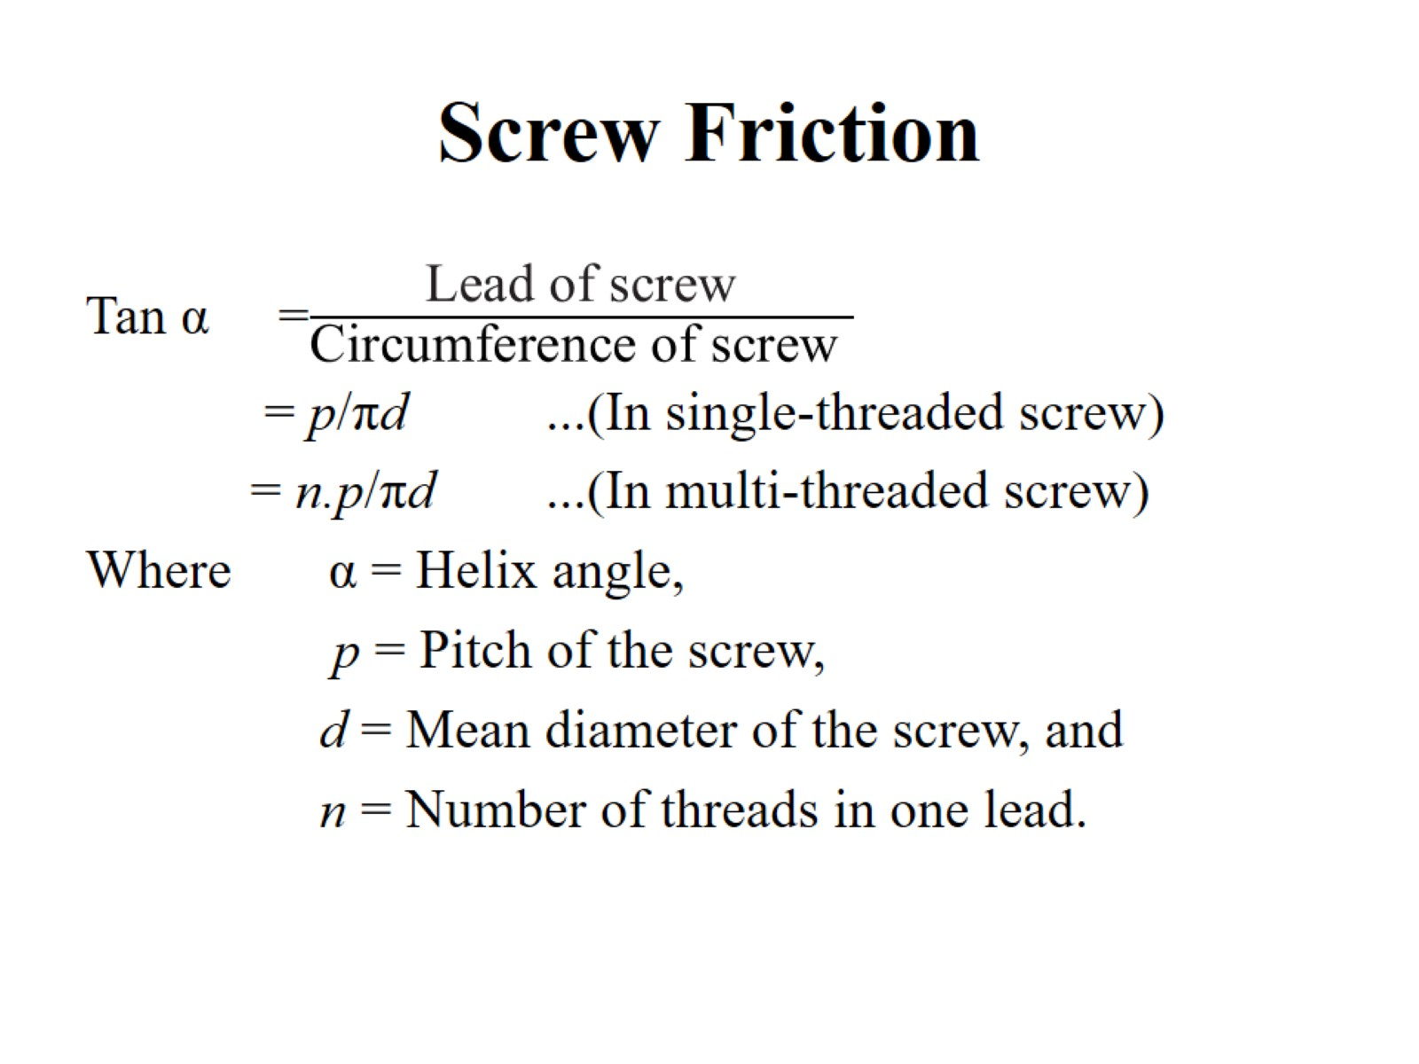
Screw Friction

Slide 33
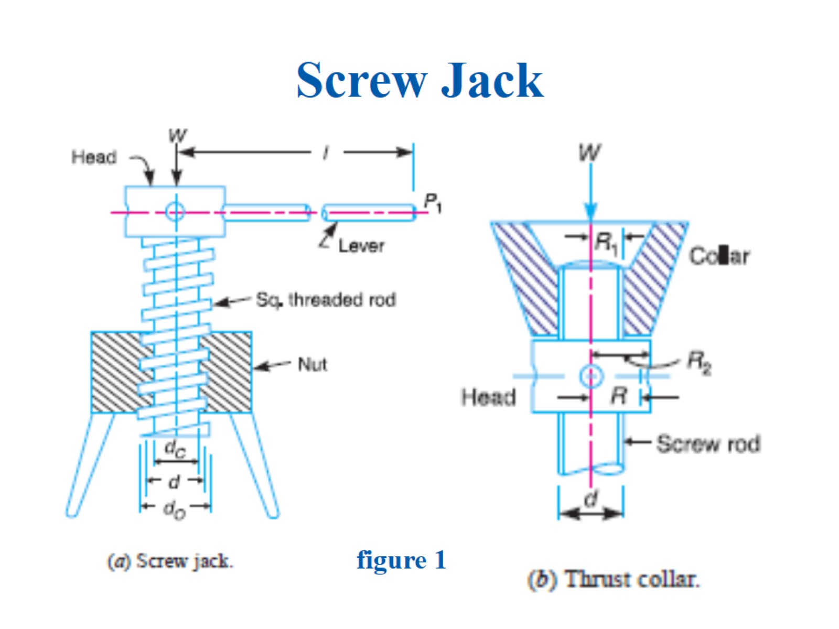
Screw Jack

Slide 34
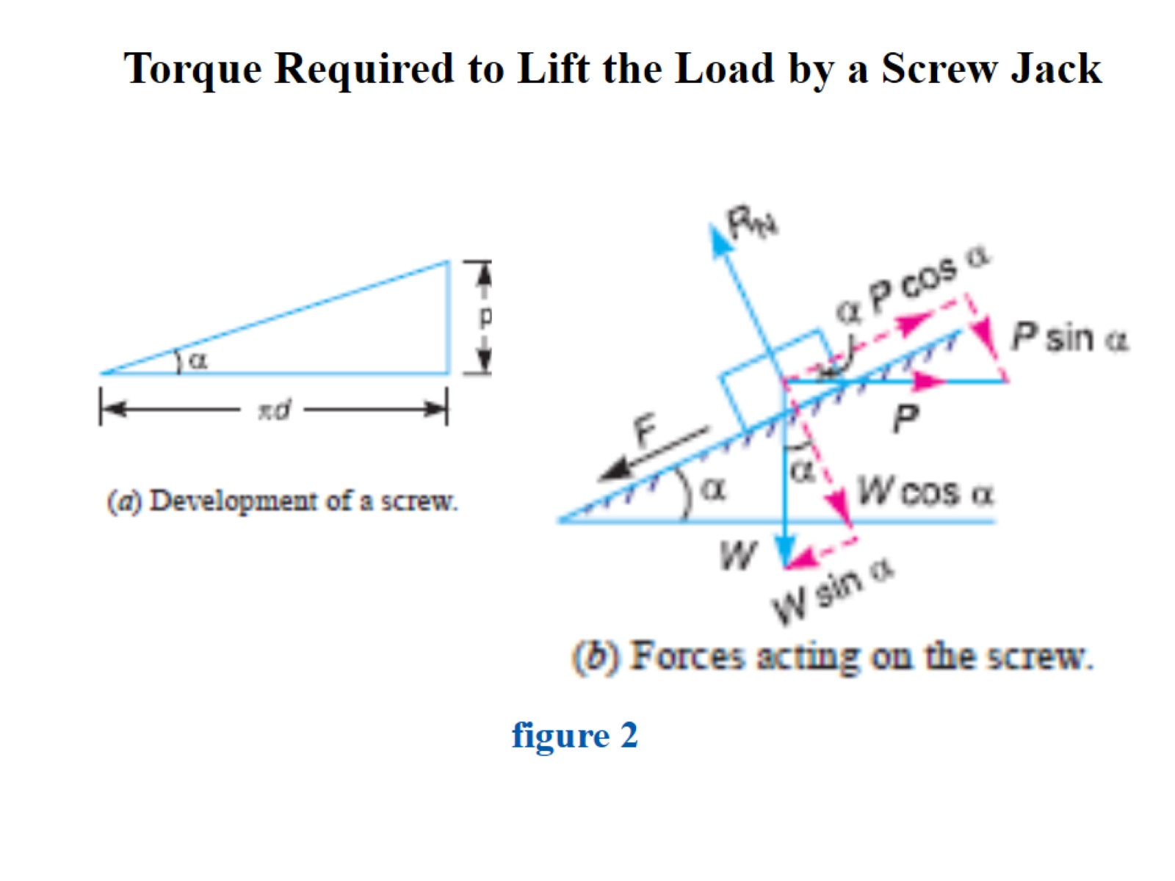
Torque Required to Lift the Load by a Screw Jack

Slide 35
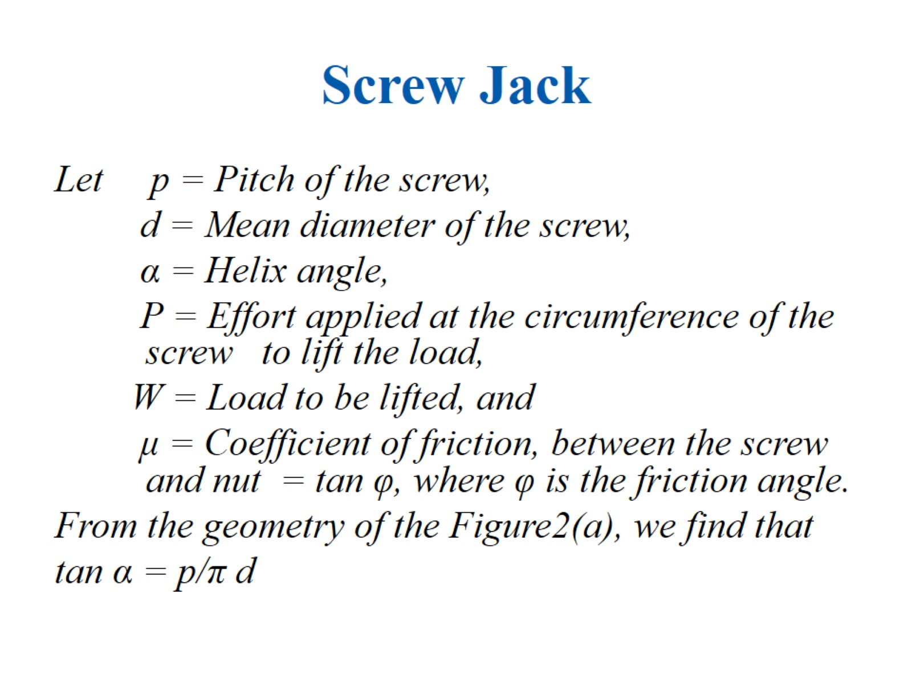
Screw Jack

Slide 36
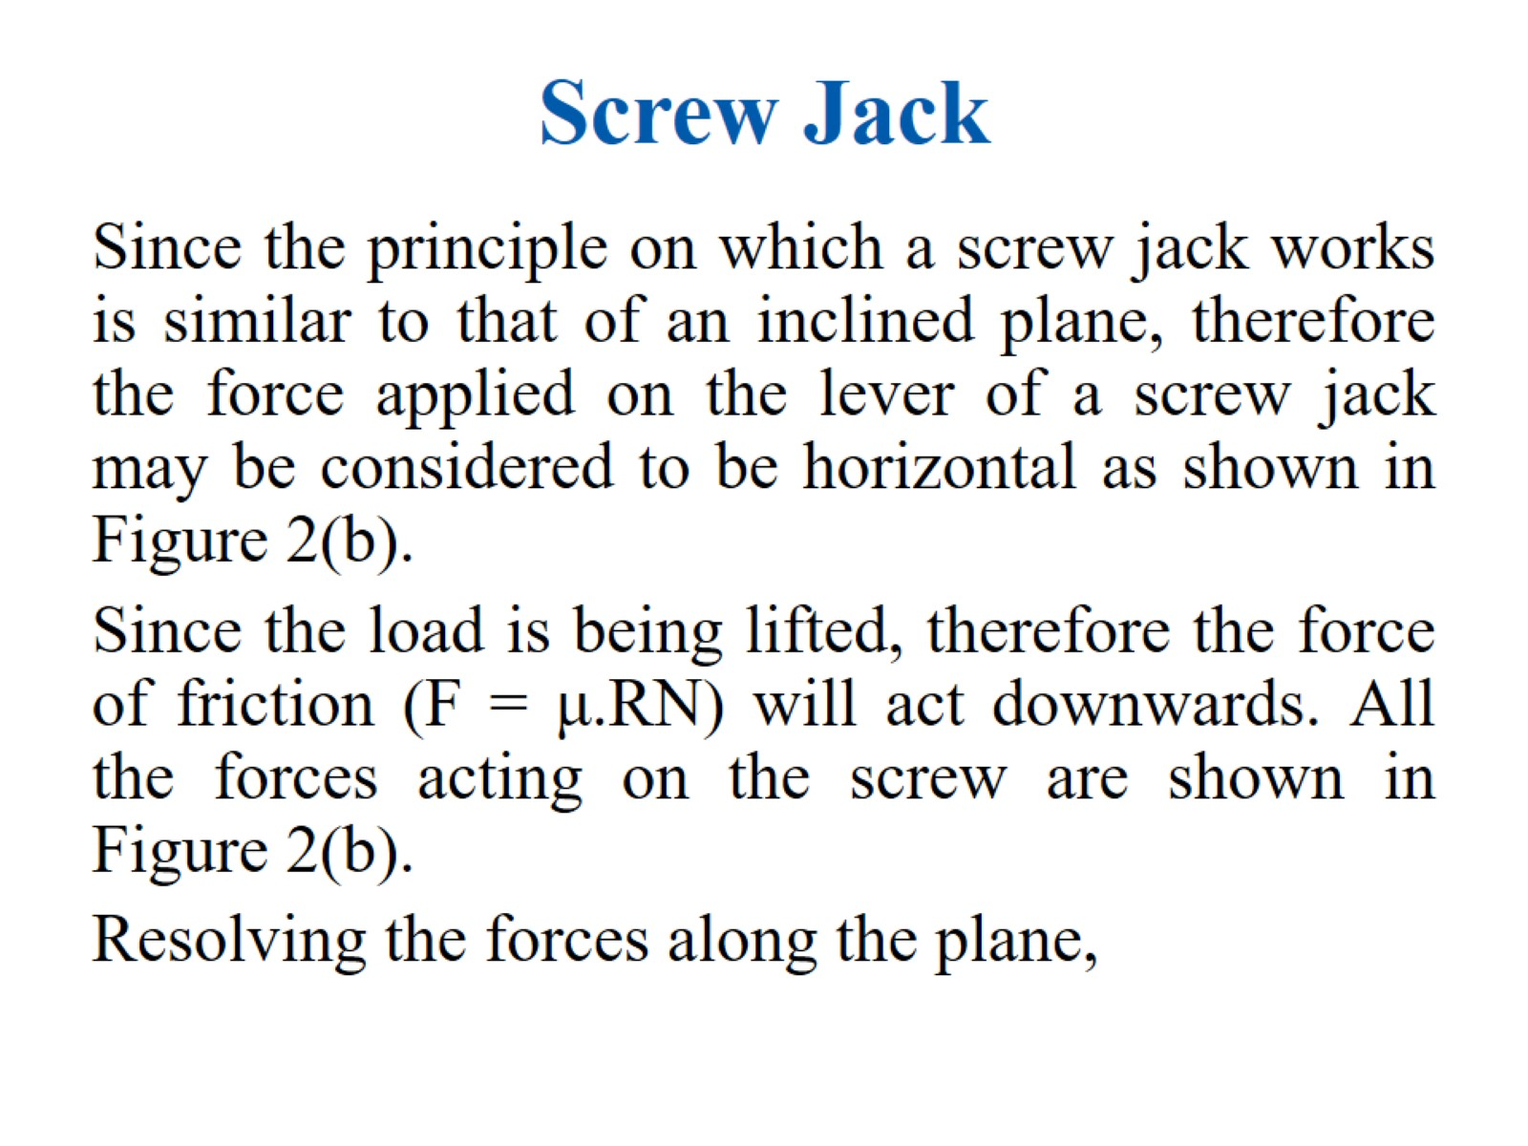
Screw Jack

Slide 37
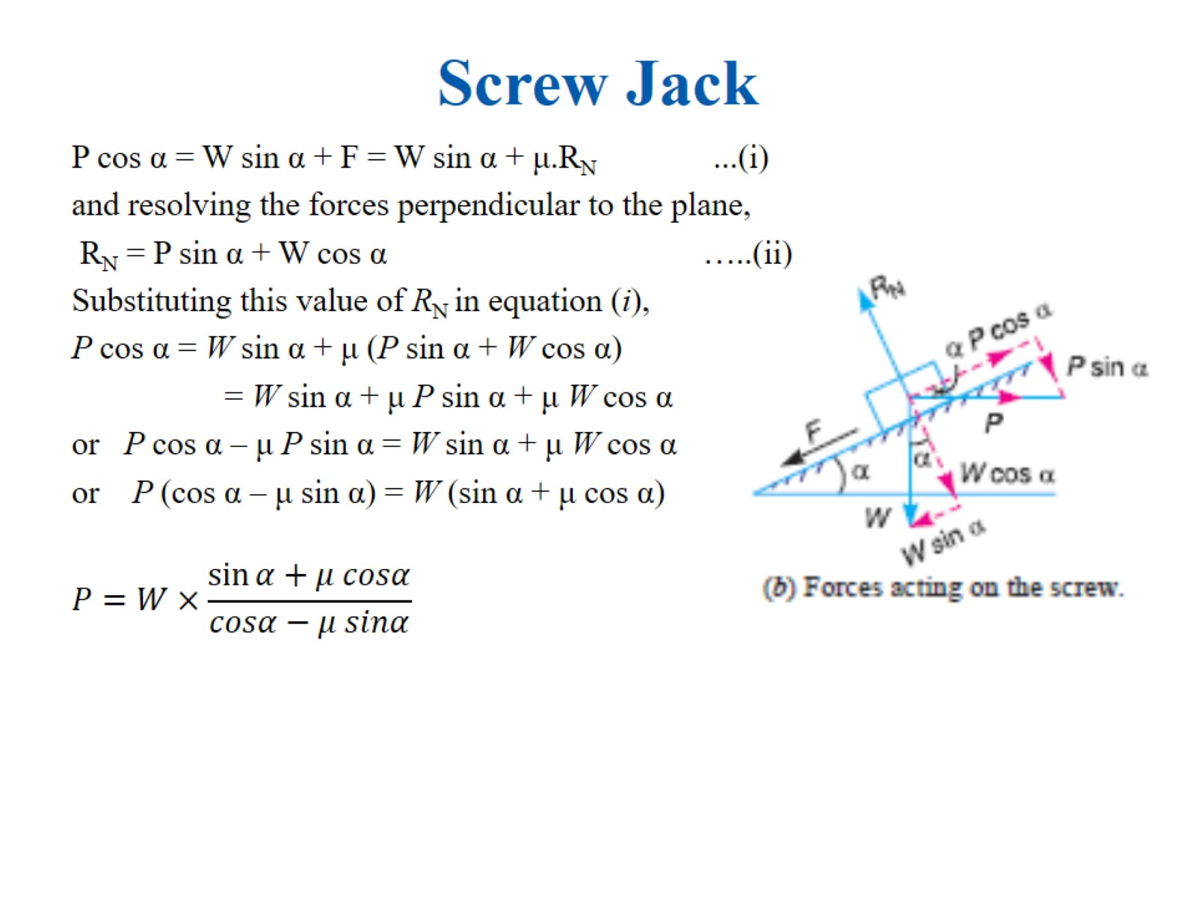
Screw Jack

Slide 38
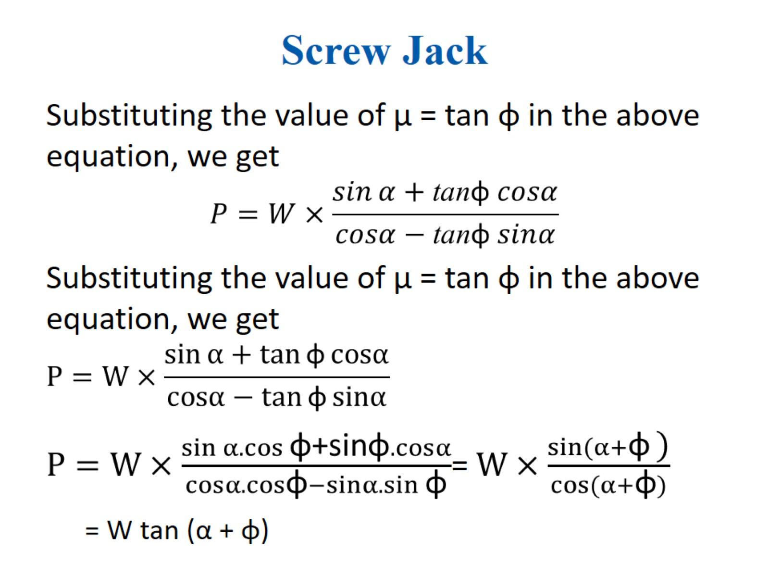
Screw Jack

Slide 39
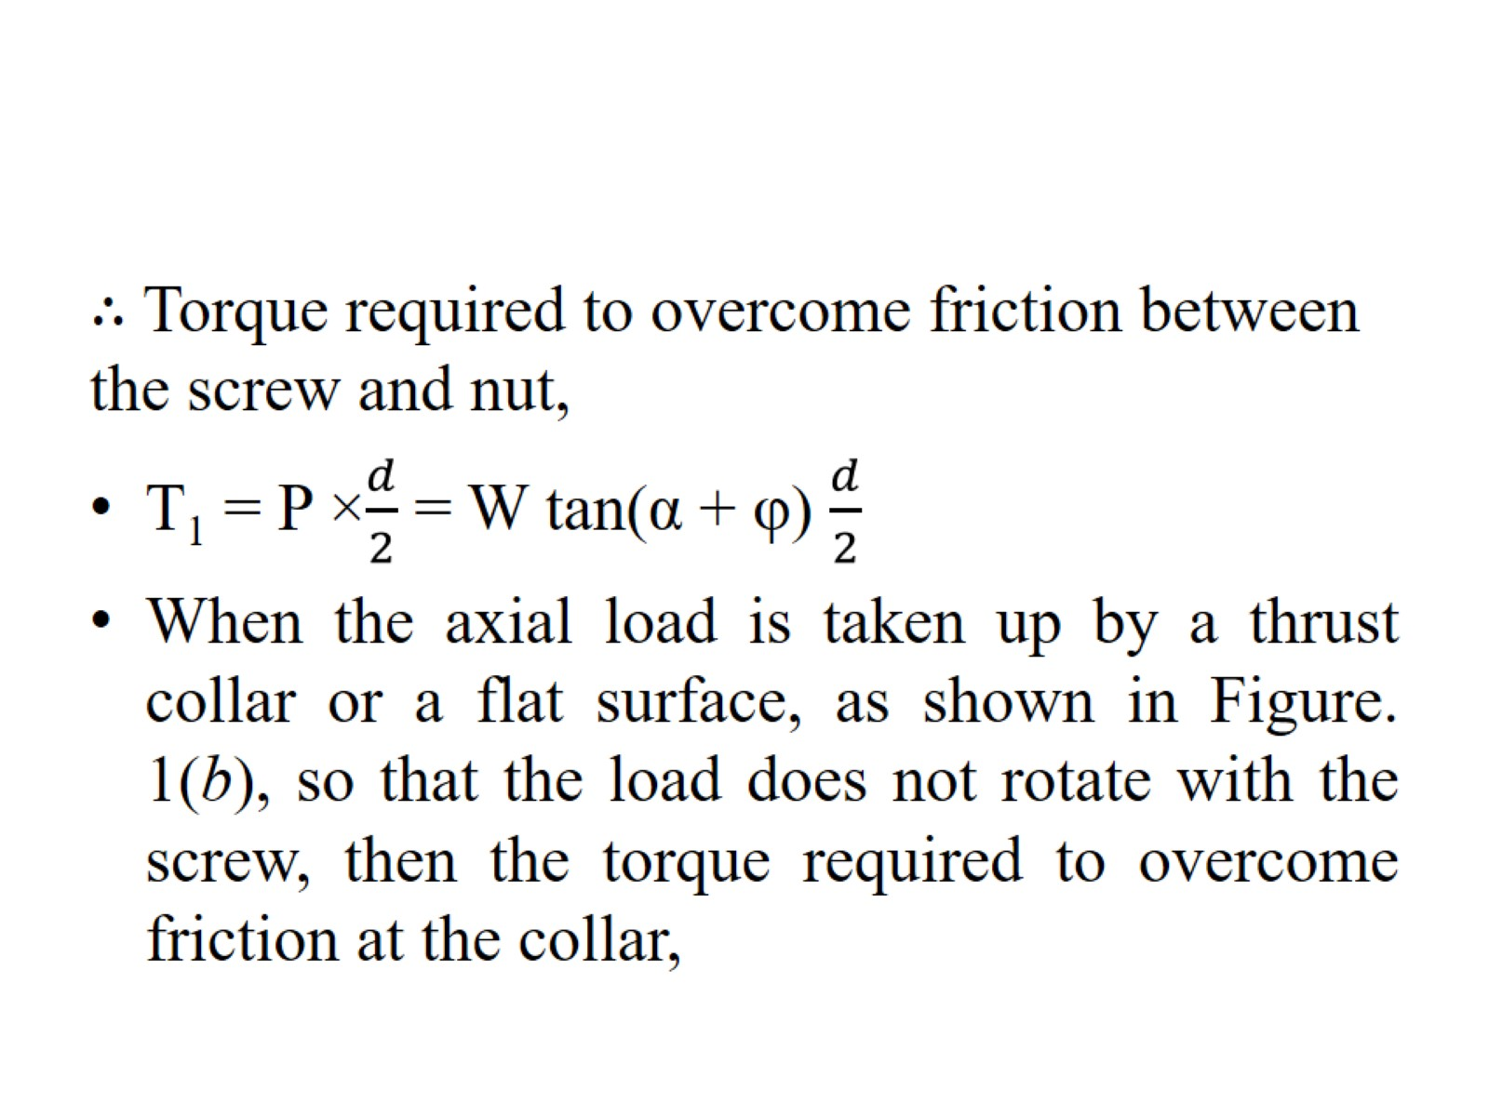

Slide 40
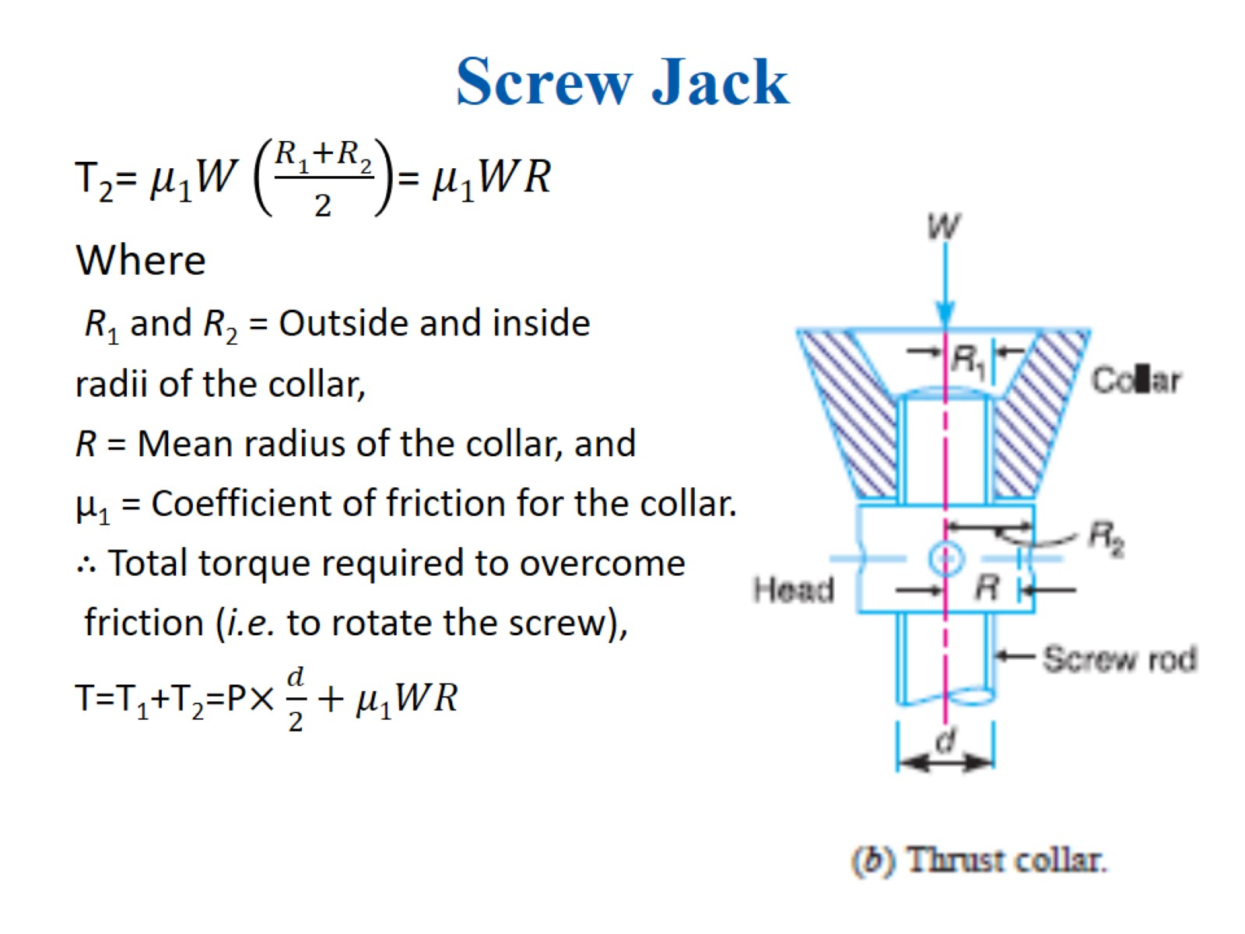
Screw Jack

Slide 41
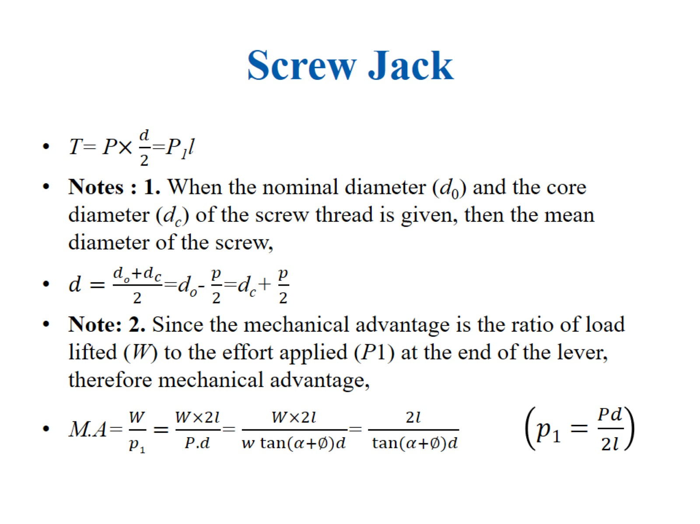
Screw Jack

Slide 42
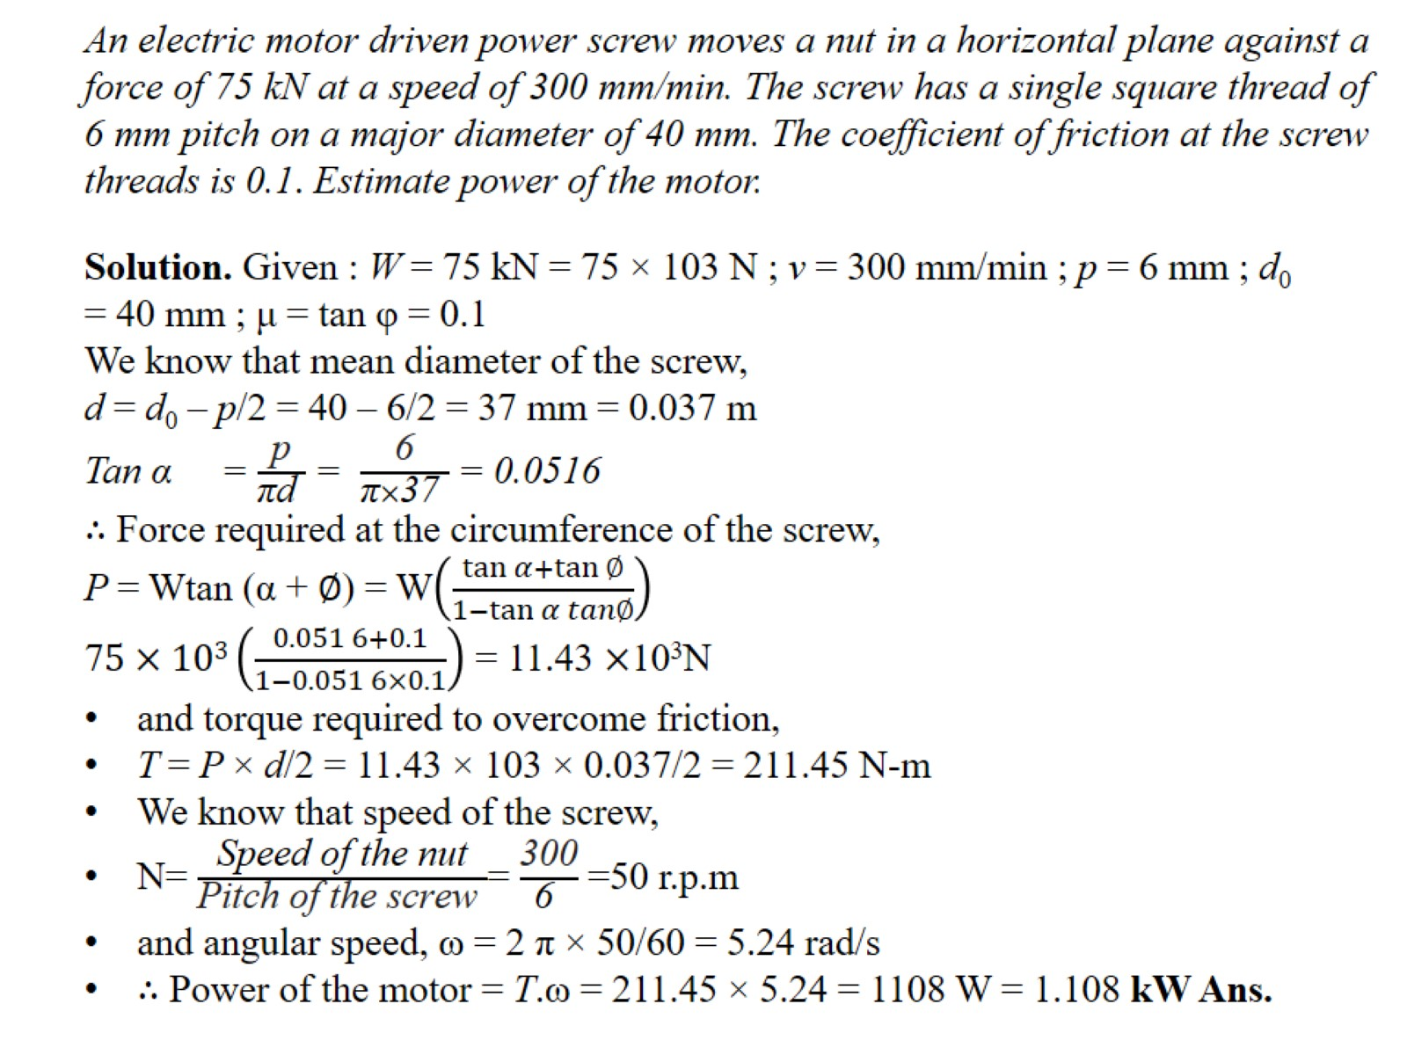
An electric motor driven power screw moves a nut in a horizontal plane against a force of 75 kN at a speed of 300 mm/min. The screw has a single square thread of 6 mm pitch on a major diameter of 40 mm. The coefficient of friction at the screw threads is 0.1. Estimate power of the motor.

Slide 43
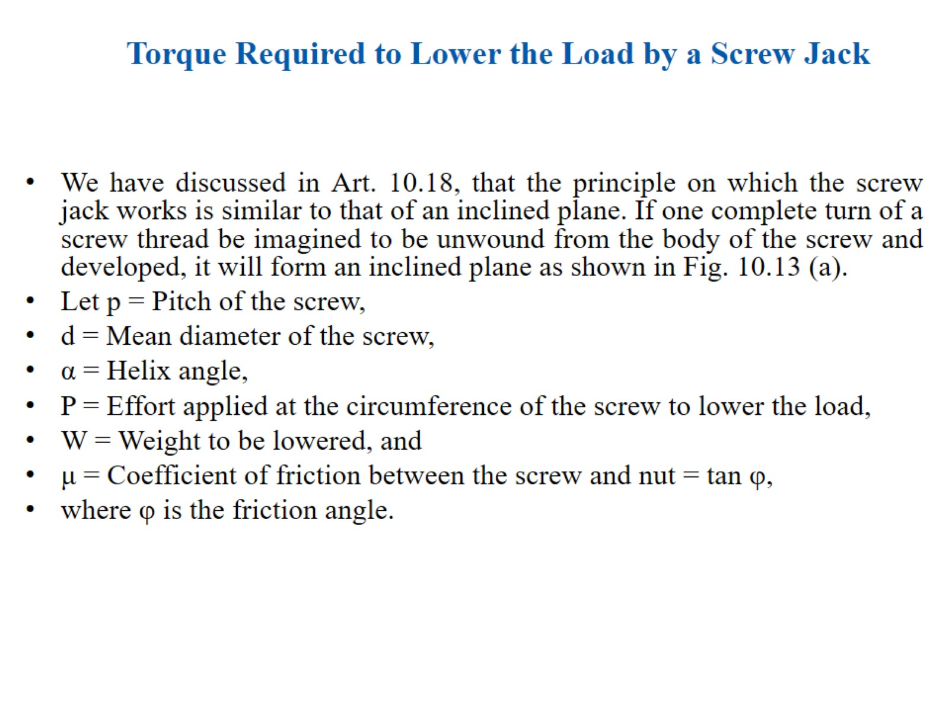
Torque Required to Lower the Load by a Screw Jack

Slide 44
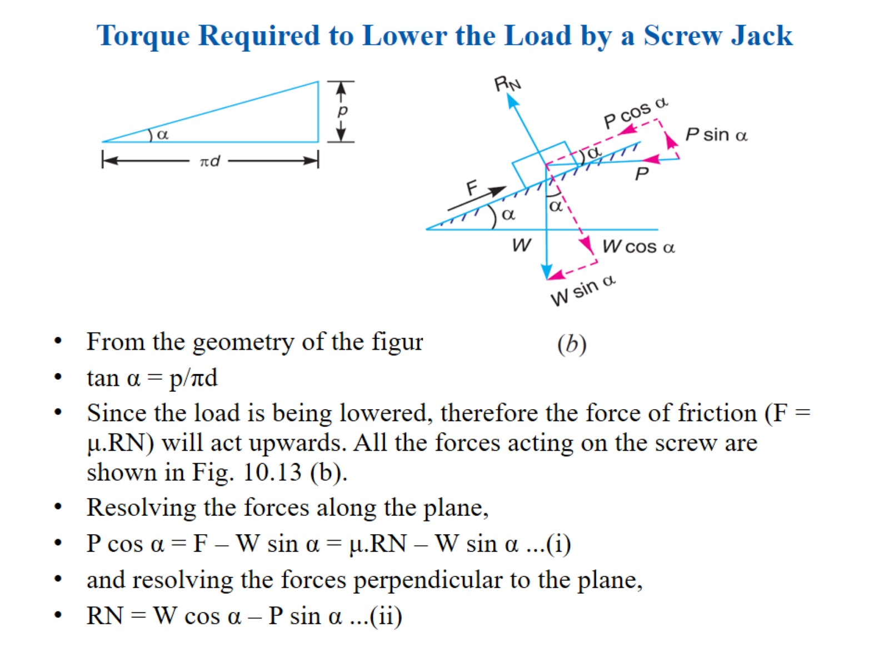
Torque Required to Lower the Load by a Screw Jack

Slide 45
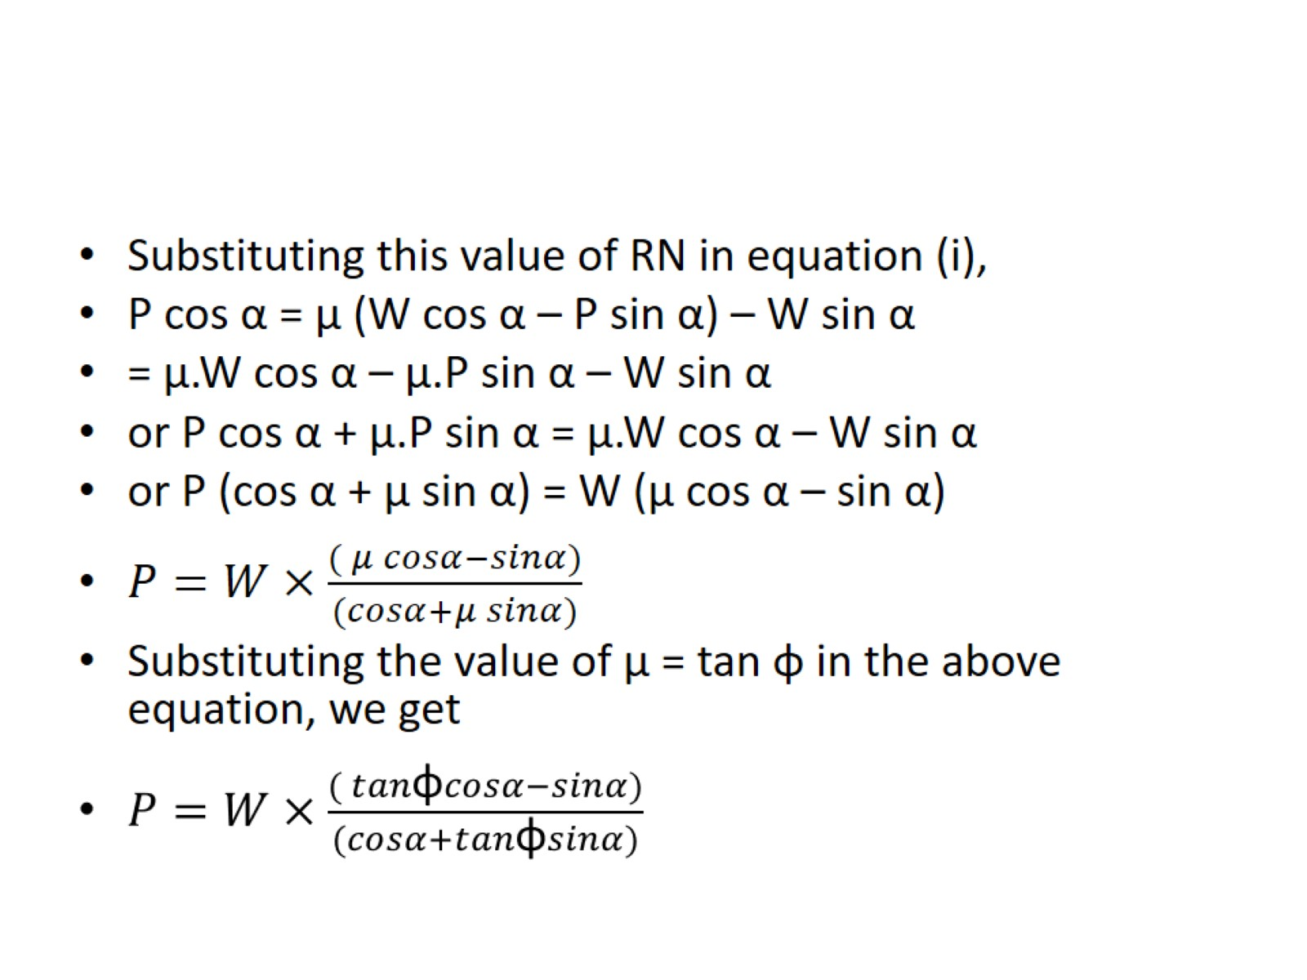

Slide 46
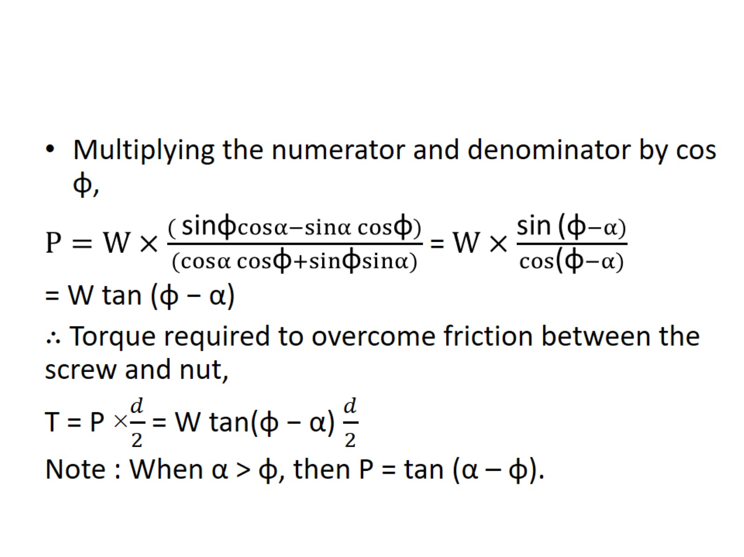

Slide 47
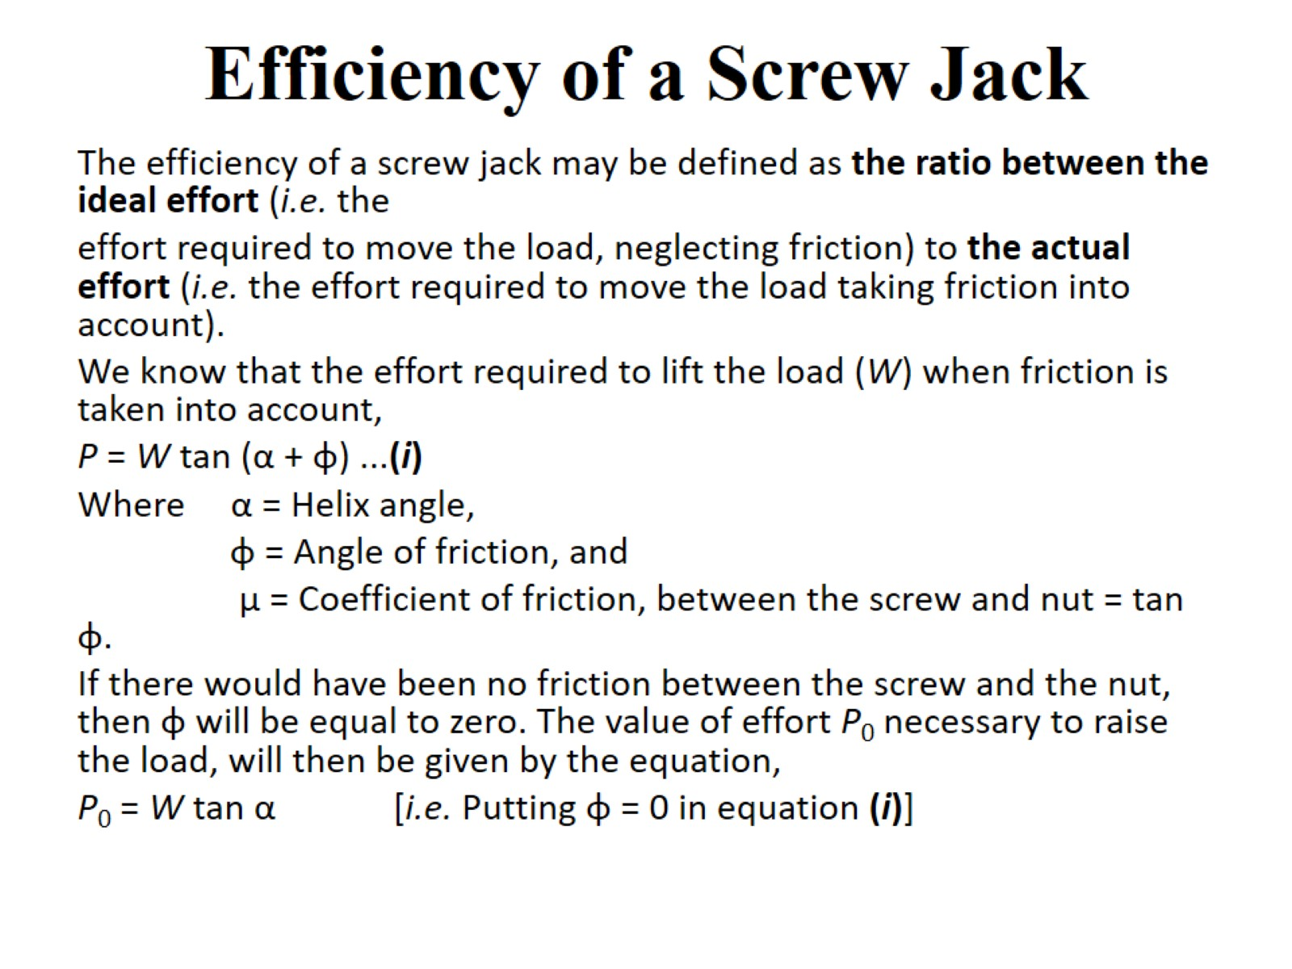
Efficiency of a Screw Jack

Slide 48
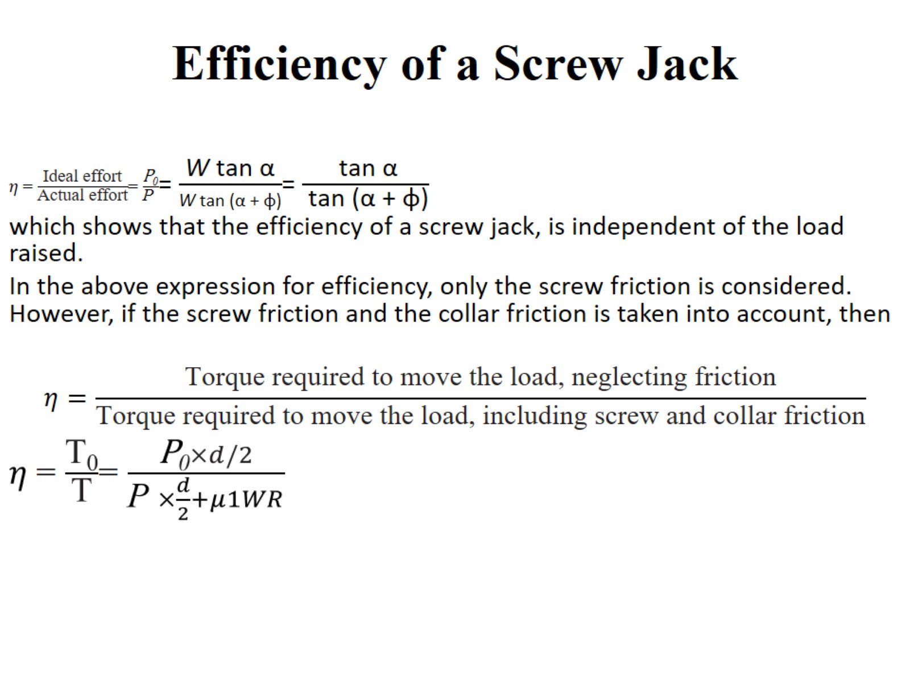
Efficiency of a Screw Jack

Slide 49
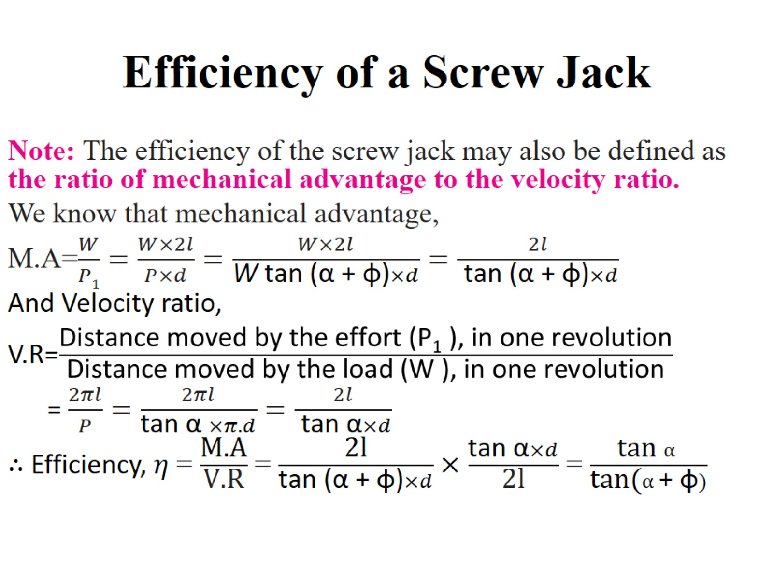
Efficiency of a Screw Jack

Slide 50
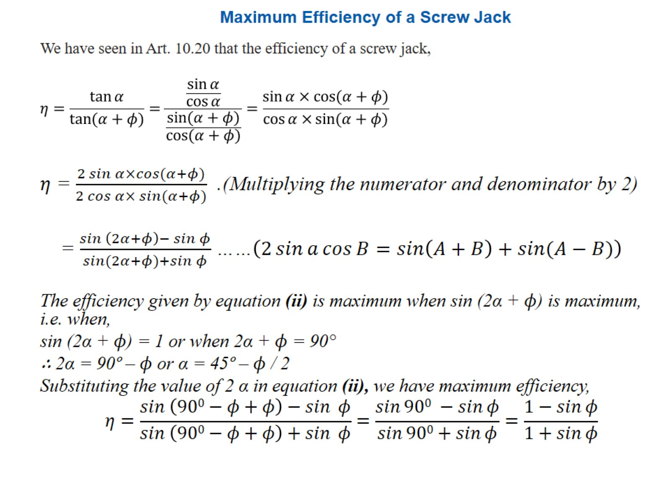
Maximum Efficiency of a Screw Jack

Slide 51


Slide 52

Example 10.10. The pitch of 50 mm mean diameter threaded screw of a screw jack is 12.5 mm. The coefficient of friction between the screw and the nut is 0.13. Determine the torque required on the screw to raise a load of 25 kN, assuming the load to rotate with the screw. Determine the ratio of the torque required to raise the load to the torque required to lower the load and also the efficiency of the machine.

Slide 53

solution

Slide 54

Friction Clutches

Slide 55

Single Disc or Plate Clutch

Slide 56

Single Disc or Plate Clutch

Slide 57

Single Disc or Plate Clutch

Slide 58

Single Disc or Plate Clutch

Slide 59

Single Disc or Plate Clutch

Slide 60

Single Disc or Plate Clutch

Slide 61

Single Disc or Plate Clutch

Slide 62

Single Disc or Plate Clutch

Slide 63

Multiple Disc Clutch

Slide 64

Multiple Disc Clutch

Slide 65

Cone Clutch

Slide 66


Slide 67

Cone Clutch

Slide 68

Cone Clutch

Slide 69

Cone Clutch

Slide 70

Cone Clutch

Slide 71

Cone Clutch

Slide 72


Slide 73


